Slide 1
I Have a Body and I Can Do Many Things with My Body
Week 6
Cherrie Ann A. Dela Cruz

Slide 2
Day 1: I have a body, My body has different parts

Slide 3
Jollibee Different Parts of the body insert video here

Slide 4
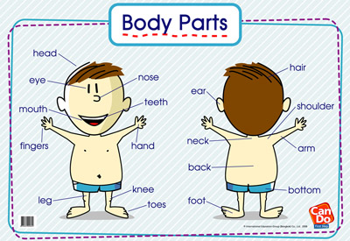
Balangkas ng Katawan

Slide 5
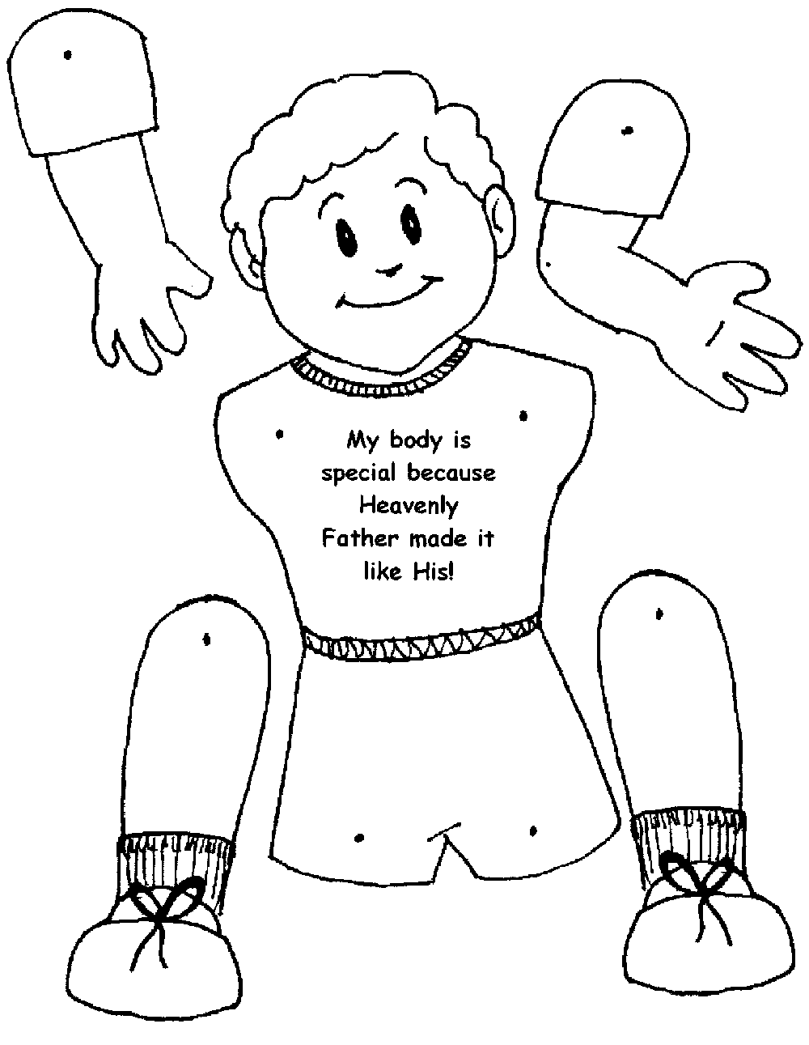
Activity 1: Picture Puzzle

Slide 6
Supervise Recess….Bless Us O Lord…

Slide 7
Story Time: Si Roy at ang Pabango ni Nanay

Slide 8
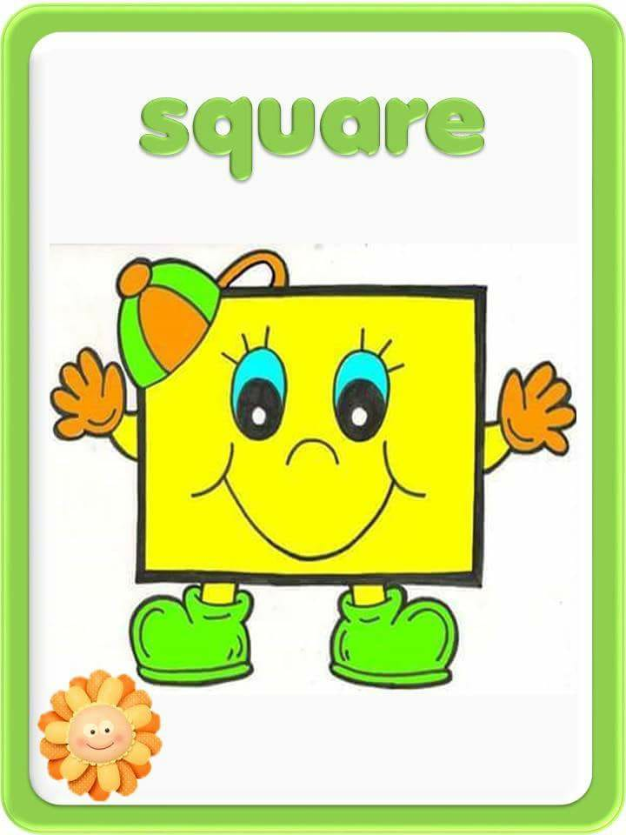
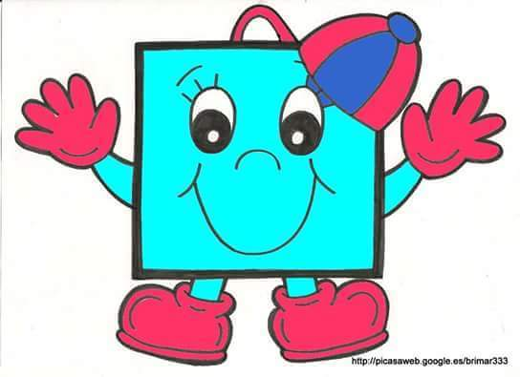
Activity 2: Shape Poster Square

Slide 9
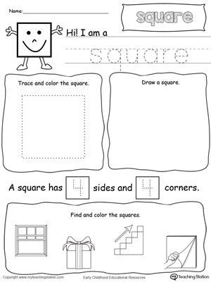
Activity 3: Hi I am Square

Slide 10
Goodbye song: Teacher Cleo

