Slide 1
I Have a Body and I Can Do Many Things with My Body
Week 6
Cherrie Ann A. Dela Cruz

Slide 2
Day 2: I have two hands and each hand has five fingers.

Slide 3
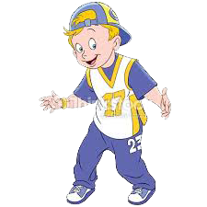
Let’s Do the Rap
I have 2 hands.
I have 5 fingers in each hand.
My hands are connected to my arms.
I can move my hands in different ways.

Slide 4
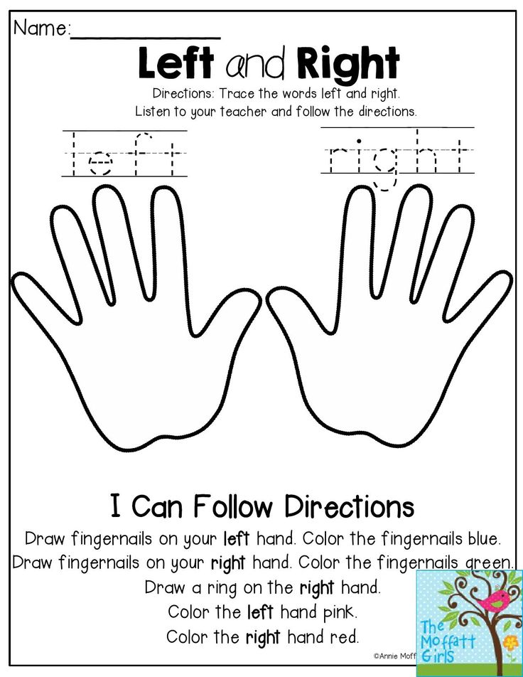
Activity 1: Hand Tracing
This is my hand.
I can write with my hand

Slide 5
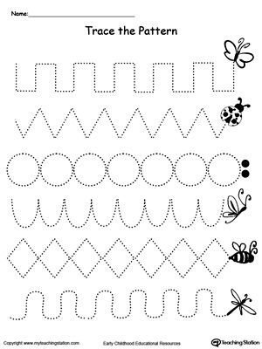
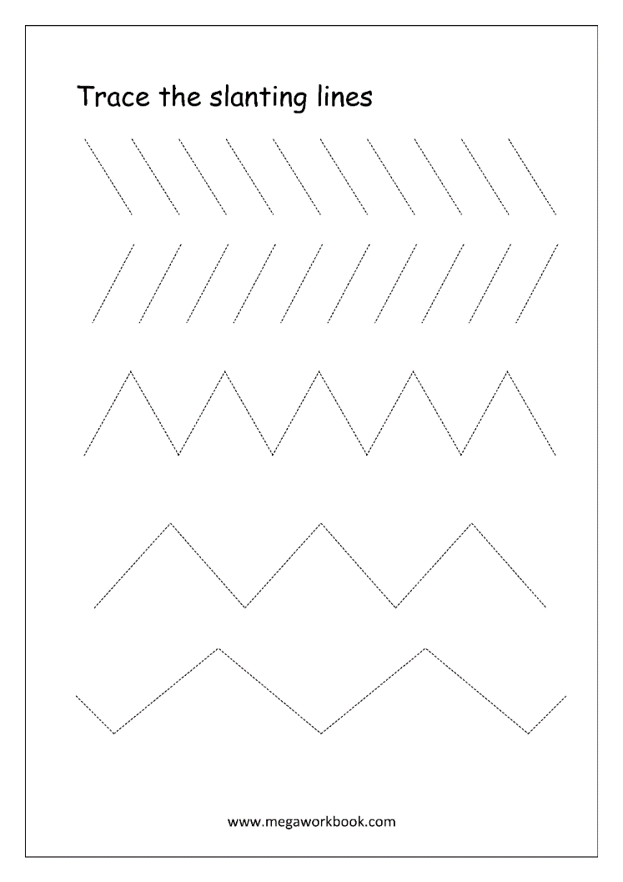
Activity 2: Trace, copy, and write different strokes.

Slide 6
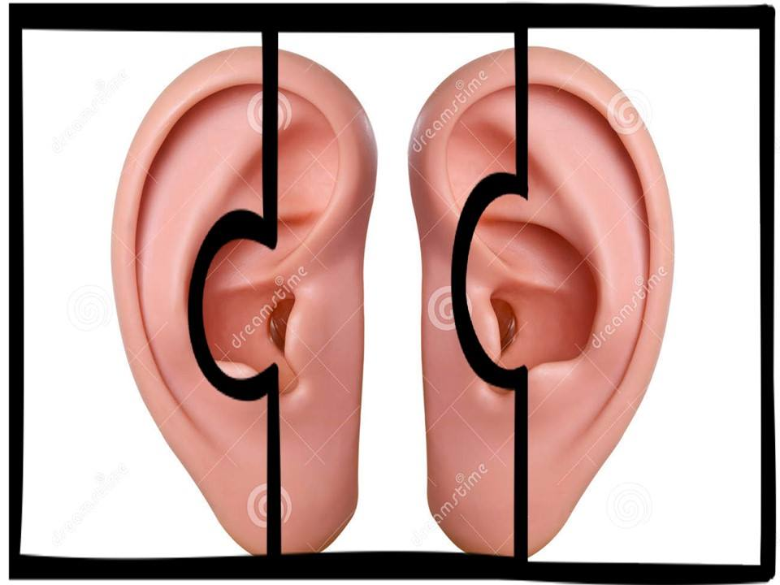
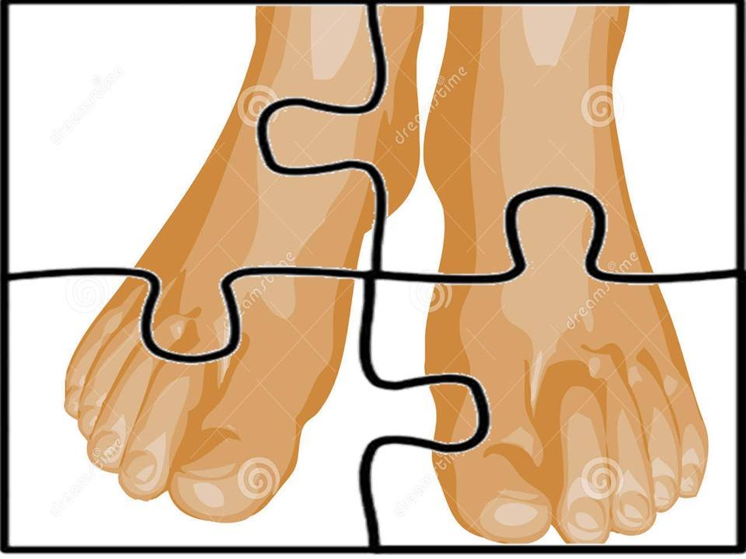
Activity 3: Picture puzzle (body parts)

Slide 7
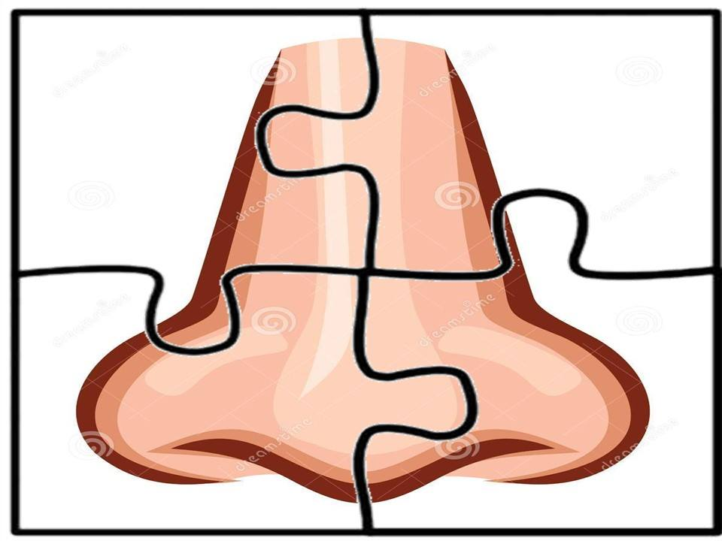
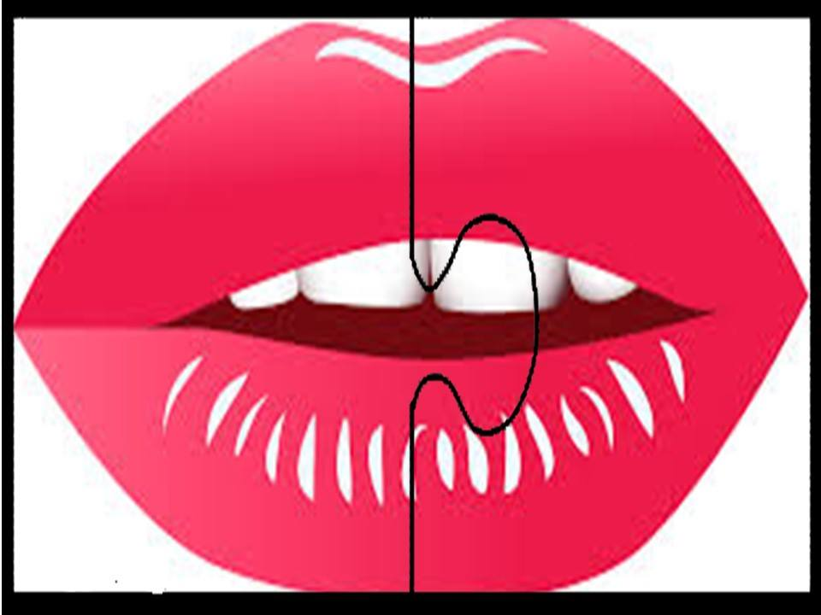
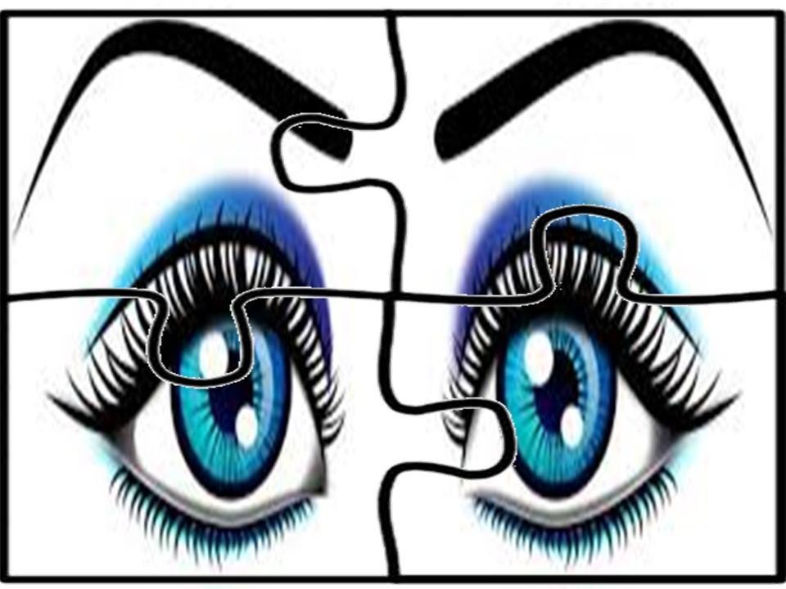
Activity 3: Picture puzzle (body parts)

Slide 8
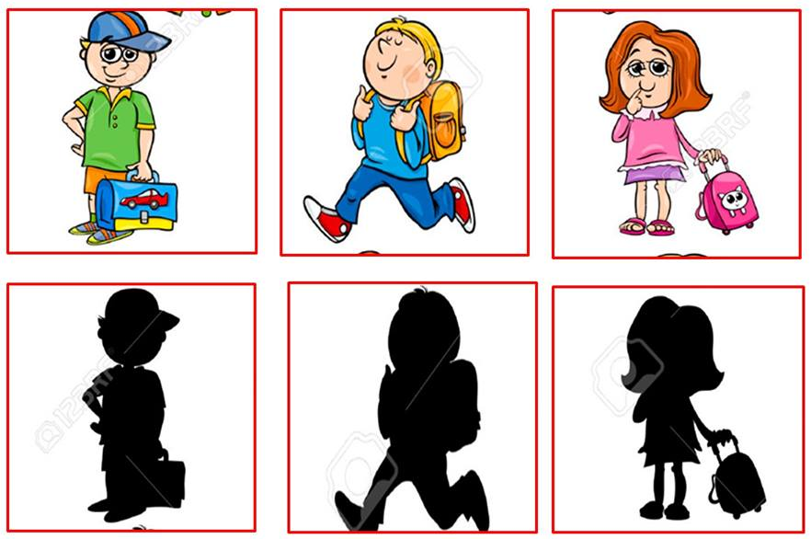
Activity 4: Shadow Match

Slide 9
Supervise Recess….Bless Us O Lord…

Slide 10
Story Time: Pinnochio

Slide 11
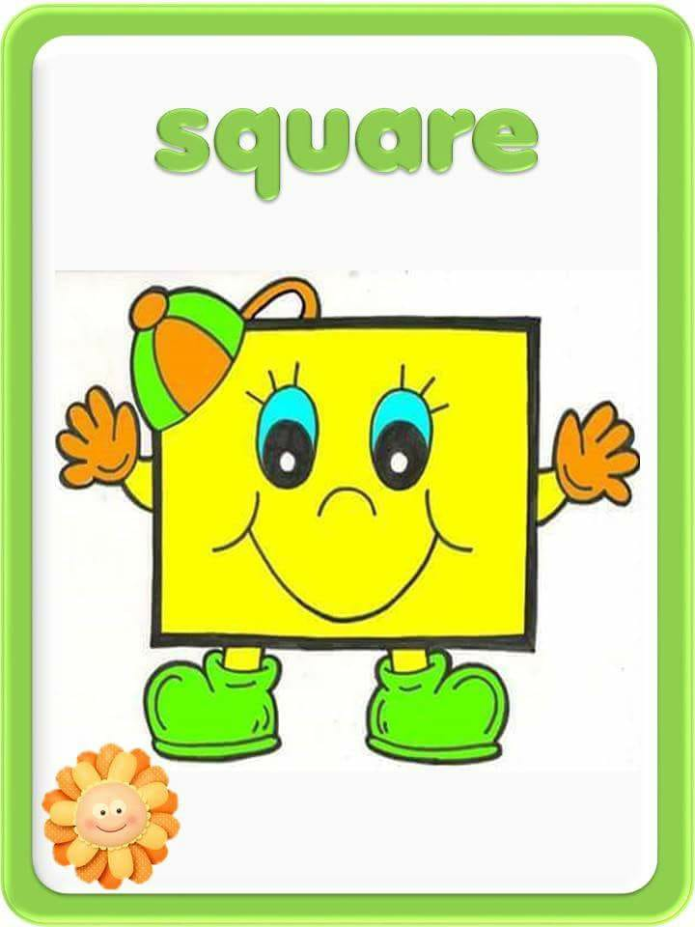
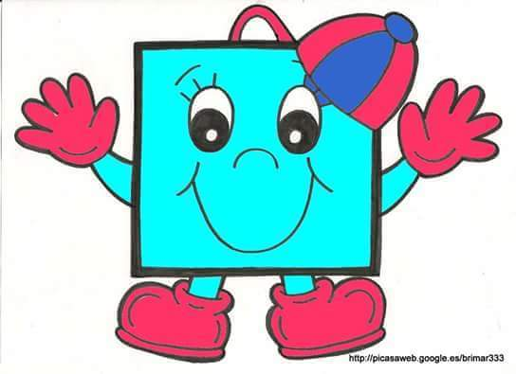
Shape Poster Square

Slide 12
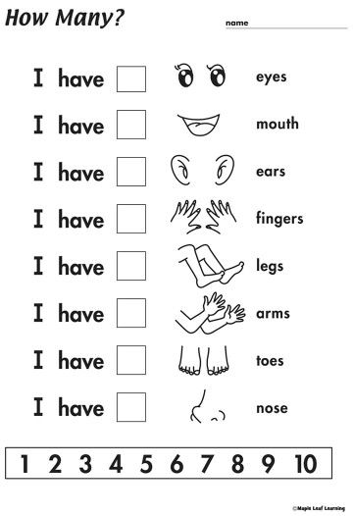
Activity 5: Counting Body Parts

Slide 13
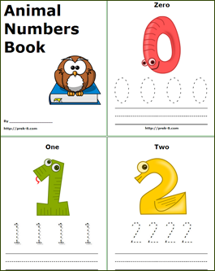
Activity 6: Number Book/Read/Write Numerals

Slide 14
Goodbye song: Teacher Cleo

