Slide 1
I Have a Body and I Can Do Many Things with My Body
Week 6
Cherrie Ann A. Dela Cruz

Slide 2
Day 4: My heart, lungs, bones and stomach are inside my body. My heart beats so it can pump blood into the body. My lungs

Slide 3
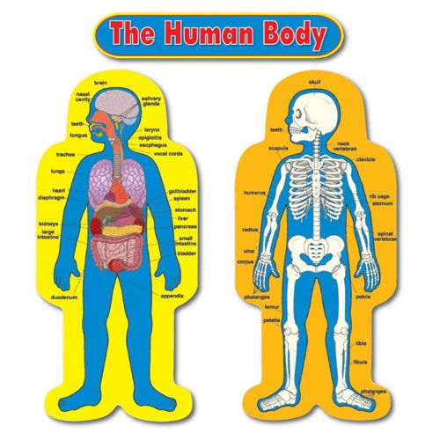
What are the parts that is inside our body?

Slide 4
My lungs help me to breath

Slide 5
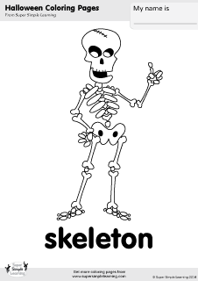
My bones give shape to my body

Slide 6
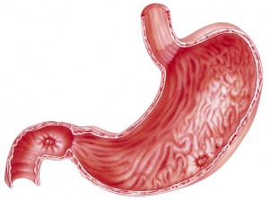
My stomach stores the food I eat.

Slide 7
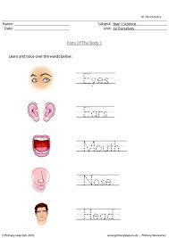
Activity 1: Parts of the Body Tracing

Slide 8
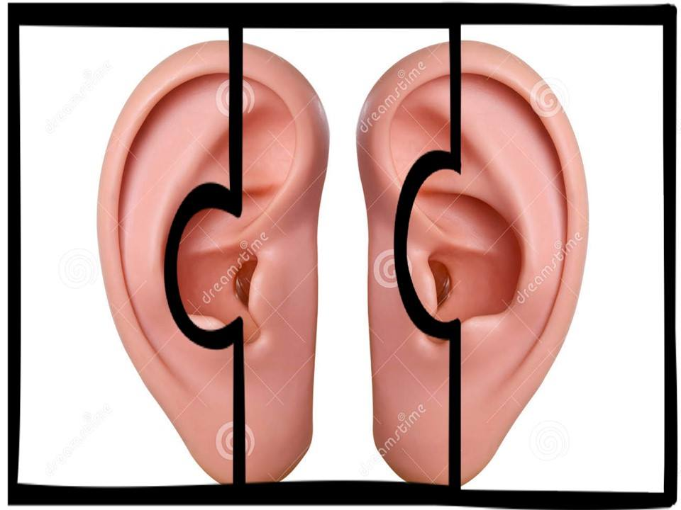
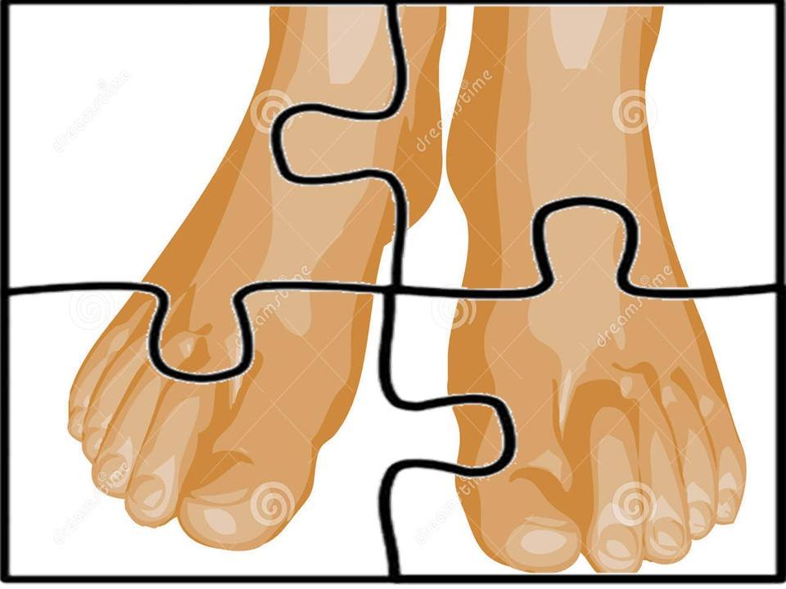
Activity 2: Picture puzzle (body parts)

Slide 9
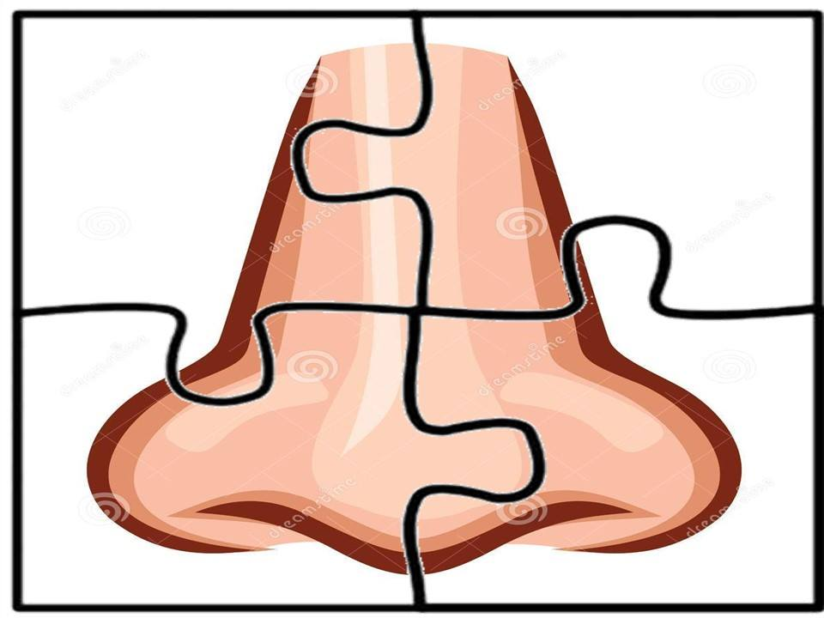
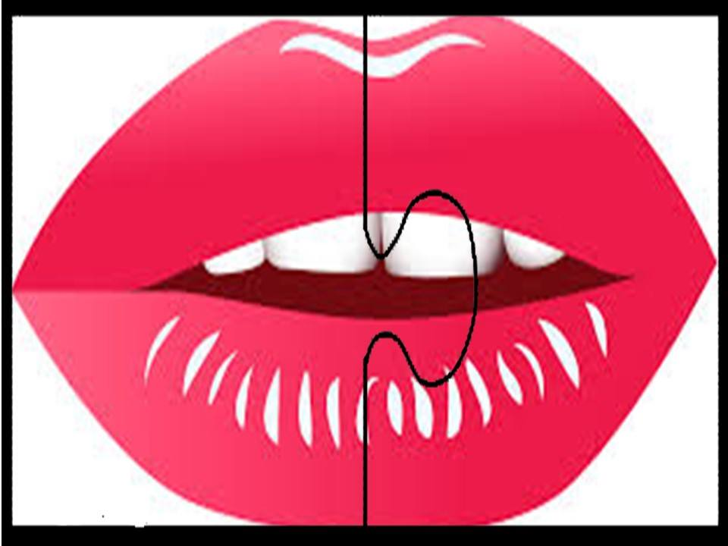
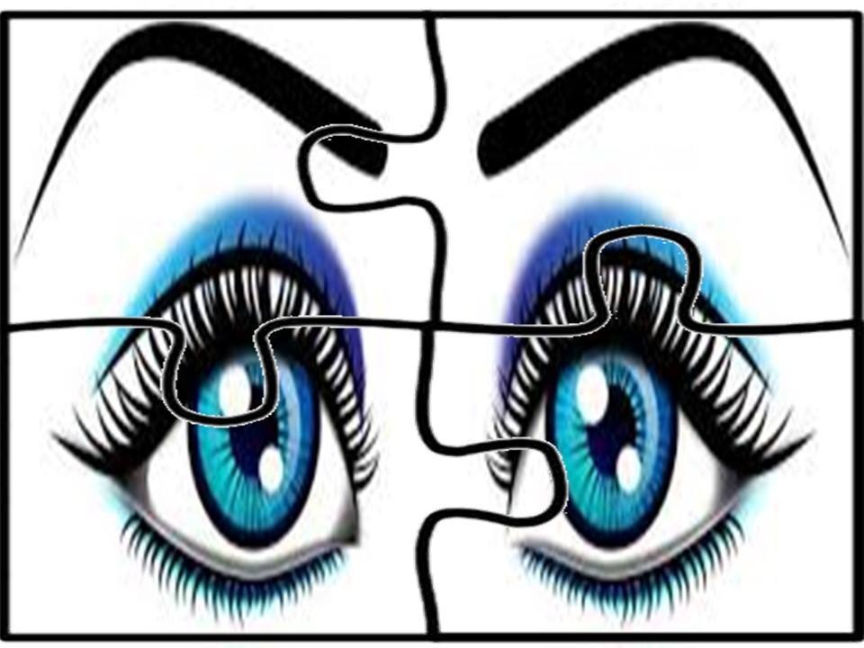
Activity 3: Picture puzzle (body parts)

Slide 10
Activity 3: Shadow Match

Slide 11
Supervised Recess….Bless Us O Lord…

Slide 12
Story Time: Chubby Chin Chin

Slide 13
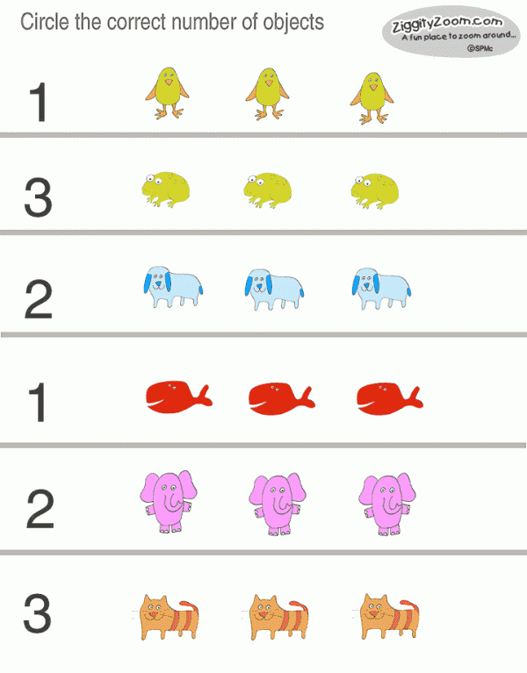
Activity 4: Counting up to 3

Slide 14
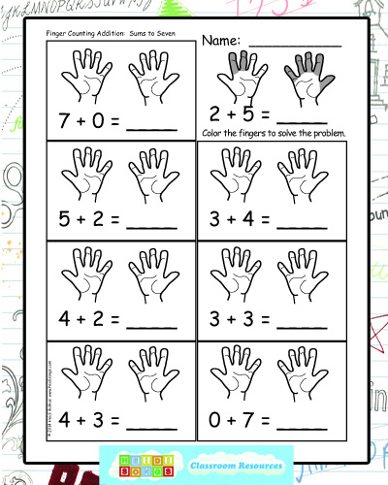
Activity 6: Finger Counting Addition

Slide 15
Goodbye song: Teacher Cleo

