Slide 1
I Can See and Hear
Week 7
Power Point Presentation by
CHERRIE ANN A. DELA CRUZ

Slide 2
I have two eyes. I see with my eyes. I can see different colors and shapes with my eyes.
Day 2

Slide 3
Daily Routine
National Anthem
Opening Prayer
Song
Attendance

Slide 4
Little Eyes
Oh be careful little eyes what you see (2x)
For the good Lord above is looking down with love
Little be careful what you see.
*little ears what you hear

Slide 5
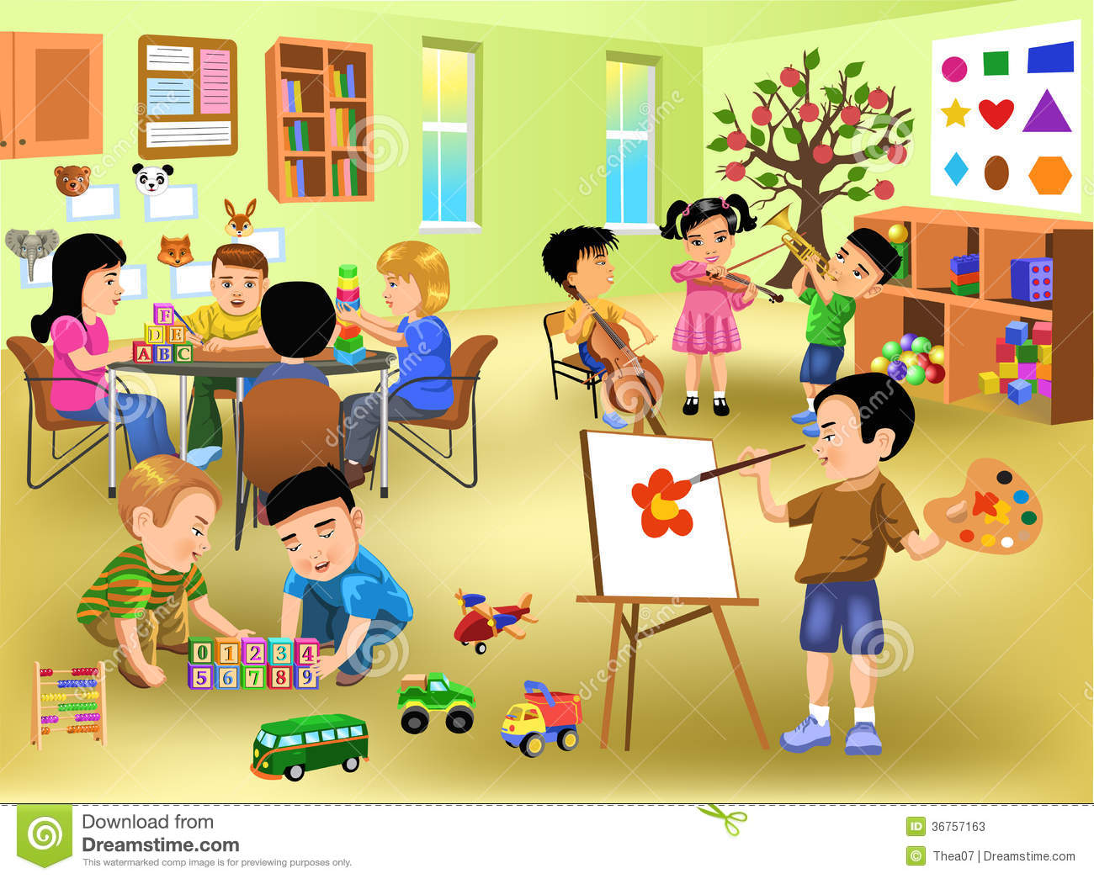
Let the learners talk about the things they see around

Slide 6
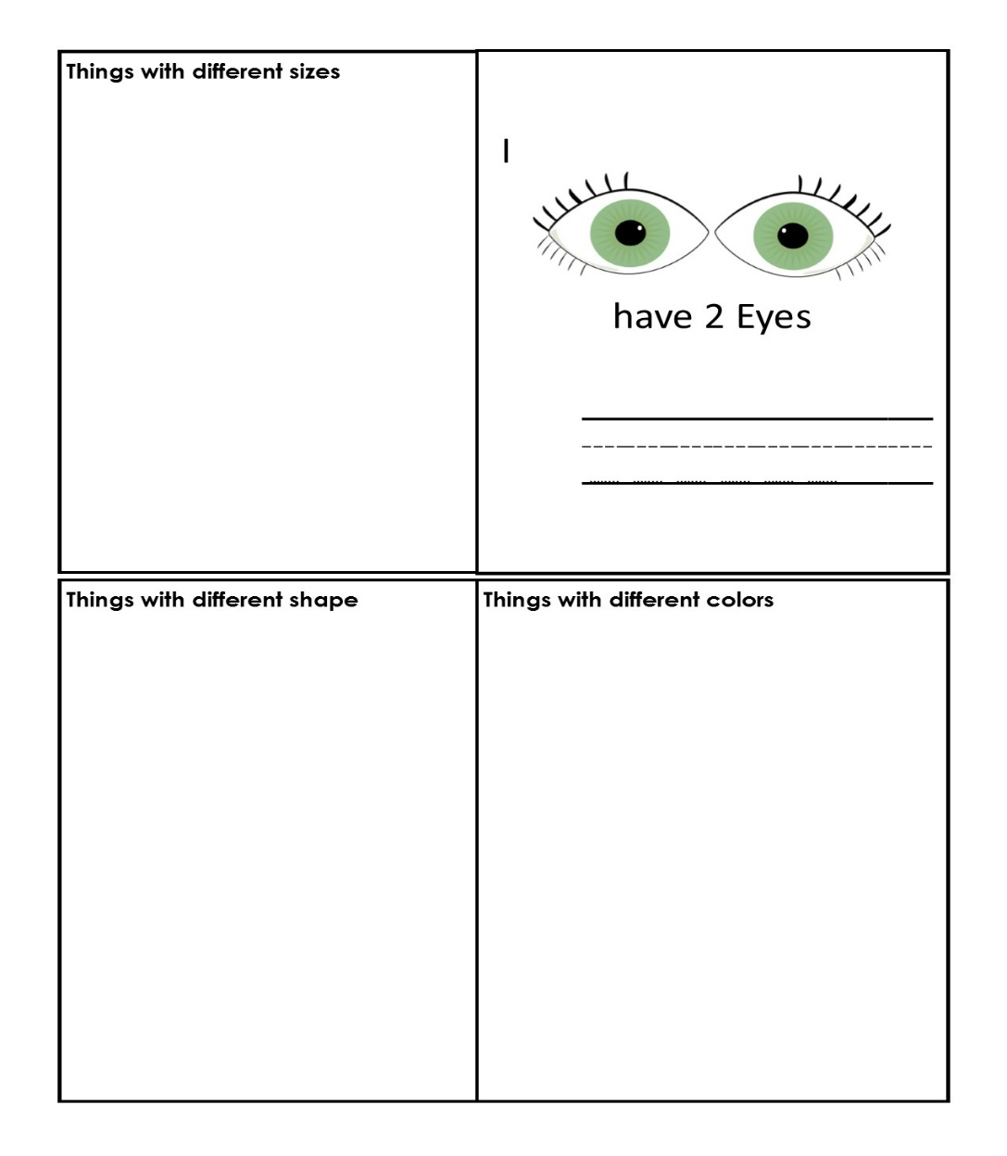
Eye Book

Slide 7
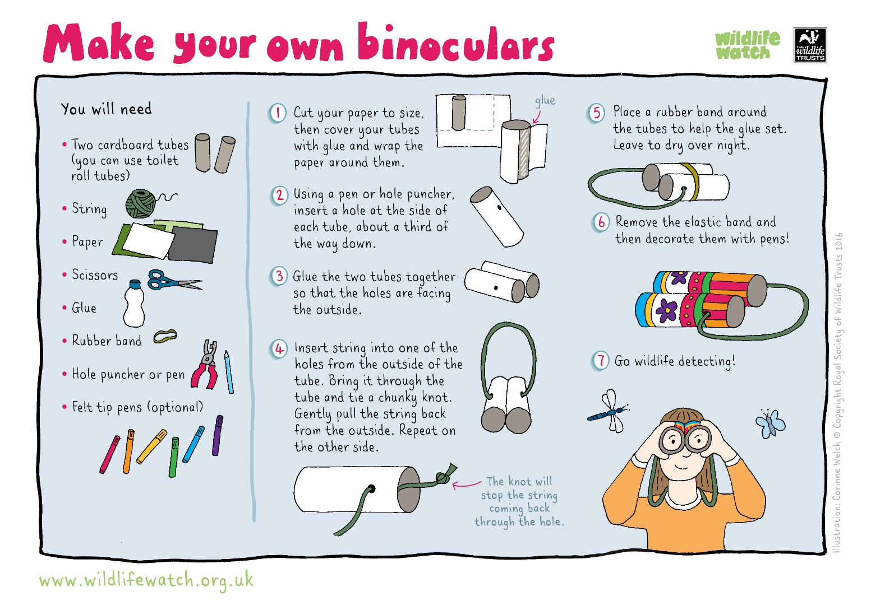
Binoculars

Slide 8
Tula: Mata
Mata ay itingin
Sa mga tanawin
Sa ating landasin
Ito’y ilaw na rin.

Slide 9
Supervised Recess

Slide 10
Story Time
Ang Alamat ng Ampalaya

Slide 11
Color Hunt

Slide 12
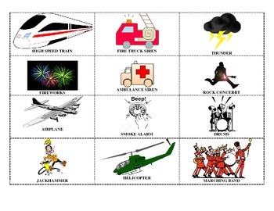
Soft and Loud Sounds

Slide 13
Let’s see Outdoor Activity

Slide 14
Good Bye Song

