Slide 1
I Can See and Hear
Week 7
Power Point Presentation by
CHERRIE ANN A. DELA CRUZ

Slide 2
I can take care of my eyes.
Day 3

Slide 3
Daily Routine
National Anthem
Opening Prayer
Song
Attendance

Slide 4
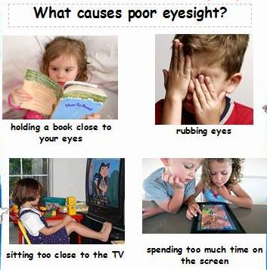
What causes poor eyesight?

Slide 5
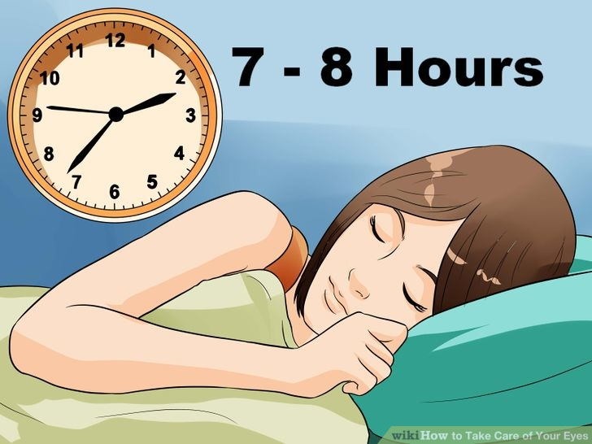
How will you take care of your eyes?
Matulog na tama sa oras

Slide 6
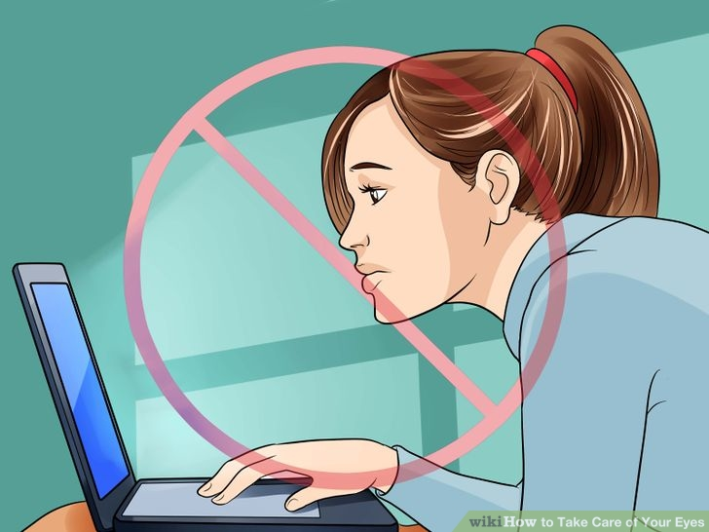
How will you take care of your eyes?
Iwasang itutok ang mata sa tv or computer

Slide 7
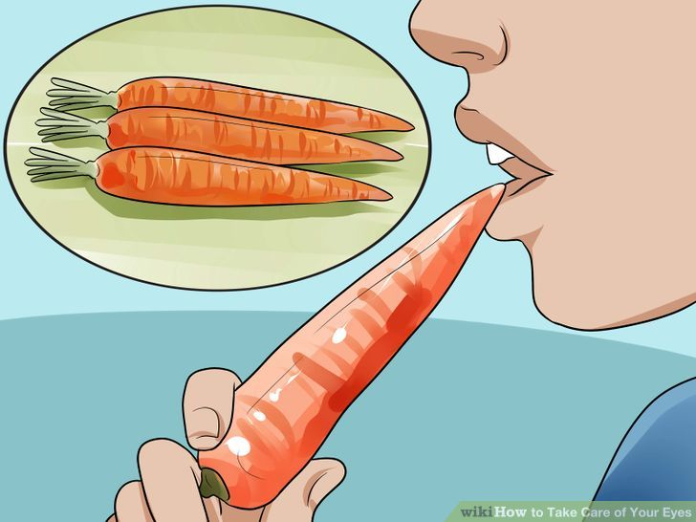
How will you take care of your eyes?
Kumain ng mga pagkaing
masustansiya

Slide 8
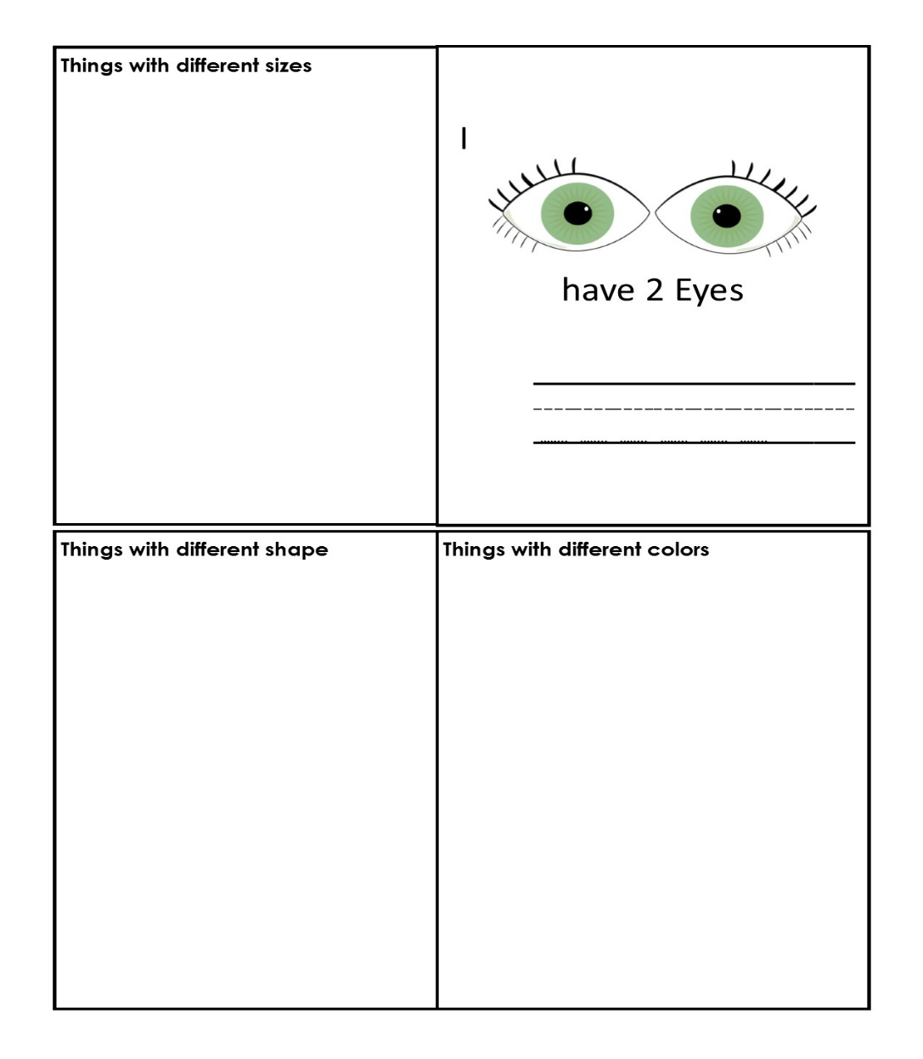
Eye Book

Slide 9
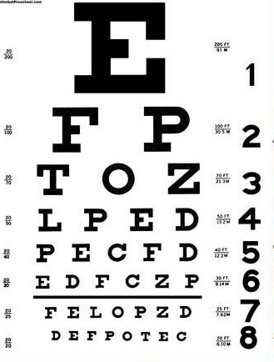
Eye Check Chart

Slide 10
Supervised Recess

Slide 11
Story Time
Ang Prinsesa At Ang Gisantes
Edited by:Bob Williams

Slide 12
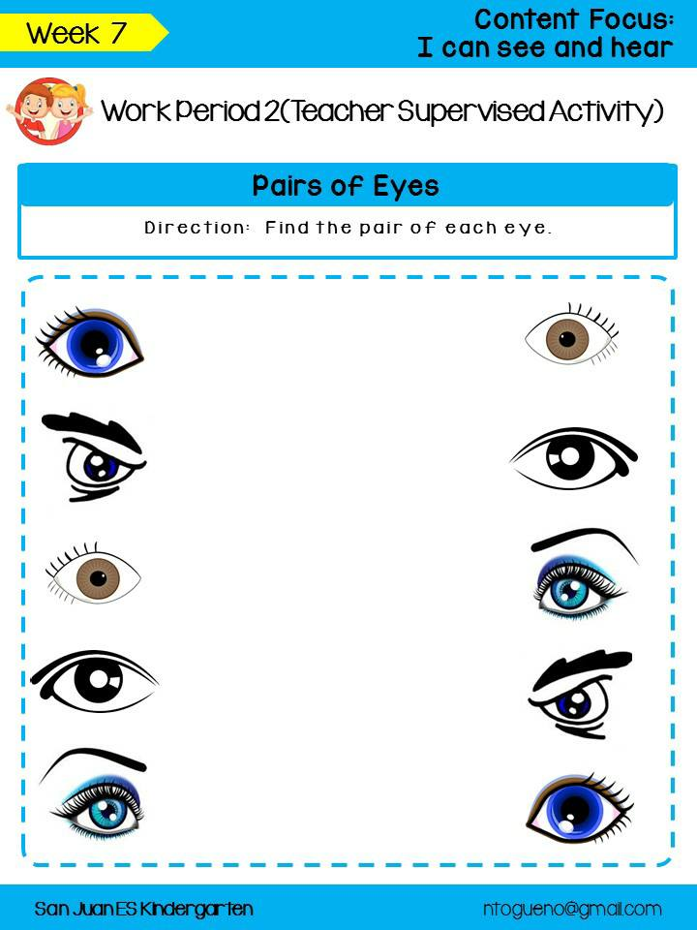
Pairs of Eyes

Slide 13
Color Memory Game

Slide 14
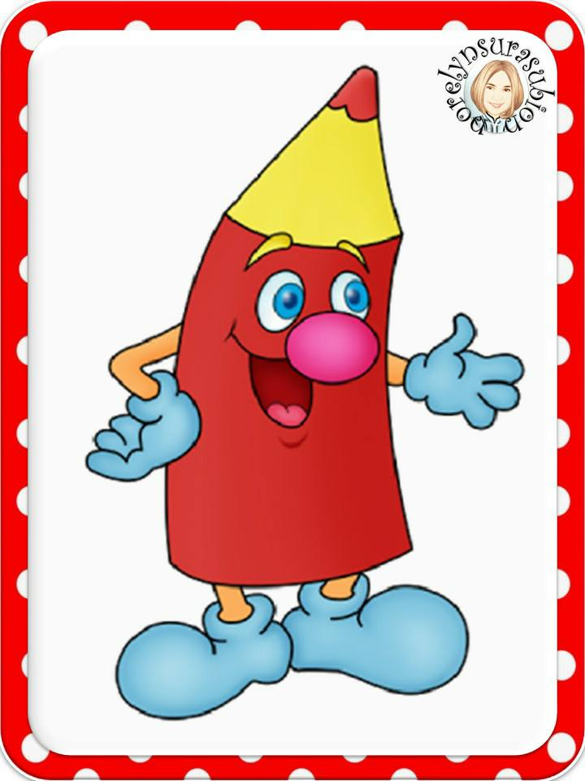
Color Memory Game

Slide 15
Unstructured Free Play Outdoor Activity

Slide 16
Learners share how they take care of their eyes.

Slide 17
Good Bye Song

