Slide 1
I Can See and Hear
Week 7
Power Point Presentation by
CHERRIE ANN A. DELA CRUZ

Slide 2
I have two ears. I can hear with my ears. I can hear different sounds with my ears.
Day 4

Slide 3
Daily Routine
National Anthem
Opening Prayer
Song
Attendance

Slide 4
Tula: Pandinig
Tainga ang pandinig
Sa ating paligid
Ligaya ang hatid
O kung may panganib
Nagpapahiwatig

Slide 5
What sounds can we hear ?
Do you hear any sound today?
What are the different sounds that can we hear everyday?
How do we hear the sounds around us?

Slide 6
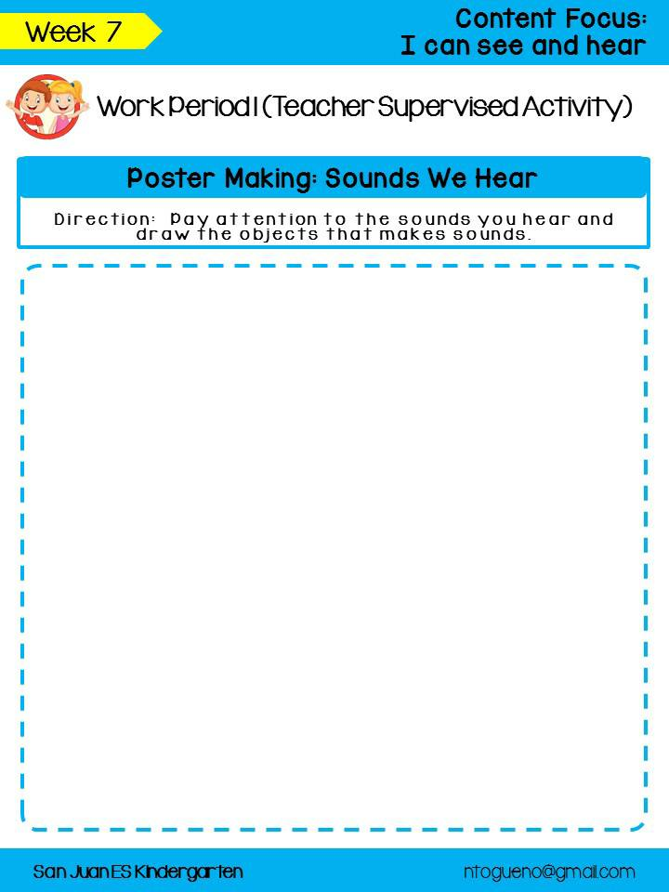
Poster Making: Sounds We Hear

Slide 7
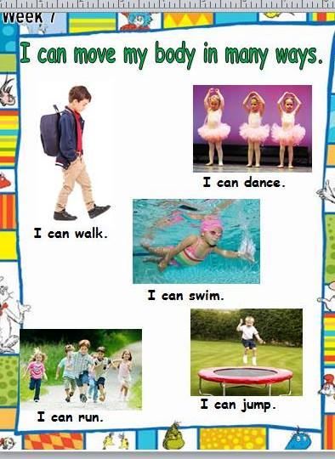

Slide 8
Supervised Recess

Slide 9
Story Time
Ayoko Na

Slide 10
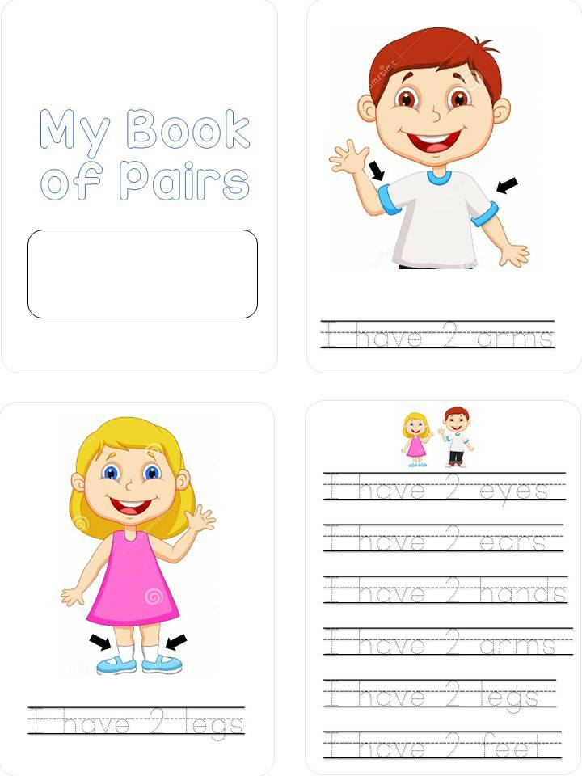
Number Book of Pairs

Slide 11
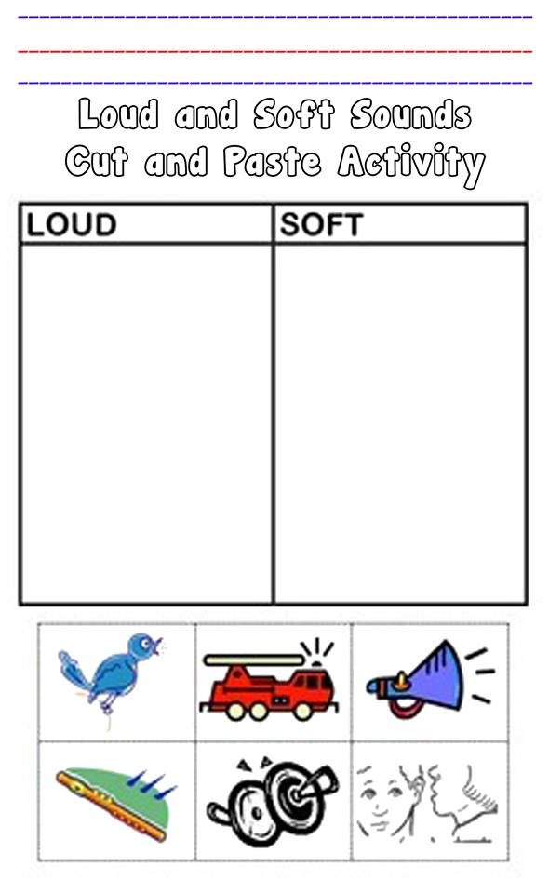
Unstructured Free Play Outdoor Activity

Slide 12
Unstructured Free Play Outdoor Activity

Slide 13
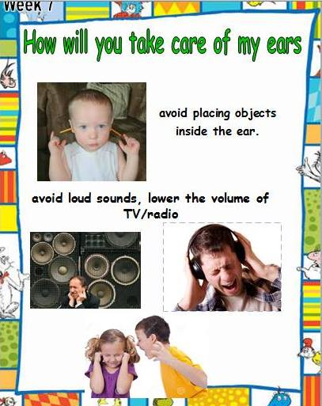
Learners give the function and importance of their ears.

Slide 14
Good Bye Song

