Slide 1
I Can See and Hear
Week 7
Power Point Presentation by
CHERRIE ANN A. DELA CRUZ

Slide 2
I can take care of my ears.
Day 5

Slide 3
Daily Routine
National Anthem
Opening Prayer
Song
Attendance

Slide 4
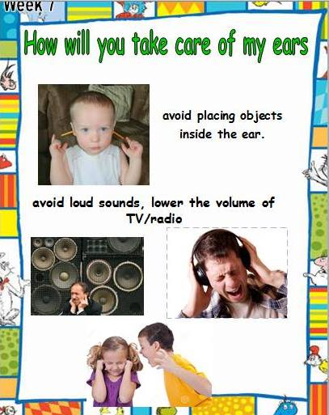
How will take care of your ears?

Slide 5
Find Me

Slide 6
Sing songs using the kitchen utensils as accompaniment

Slide 7
Supervised Recess

Slide 8
Story Time
Ang Lihim ni Kokoy Unggoy

Slide 9
Addition and Subtraction Stories

Slide 10
Blindfolded Game Outdoor Activity

Slide 11
Learners share how they take care of their ears.

Slide 12
Good Bye Song

