Slide 1
I Can Smell, Taste and Touch
Week 8
Power Point Presentation by
CHERRIE ANN A. DELA CRUZ

Slide 2
I have a nose. I can smell with my nose.
DAY 1

Slide 3
Where is your nose in your face? How many nose do you have?

Slide 4
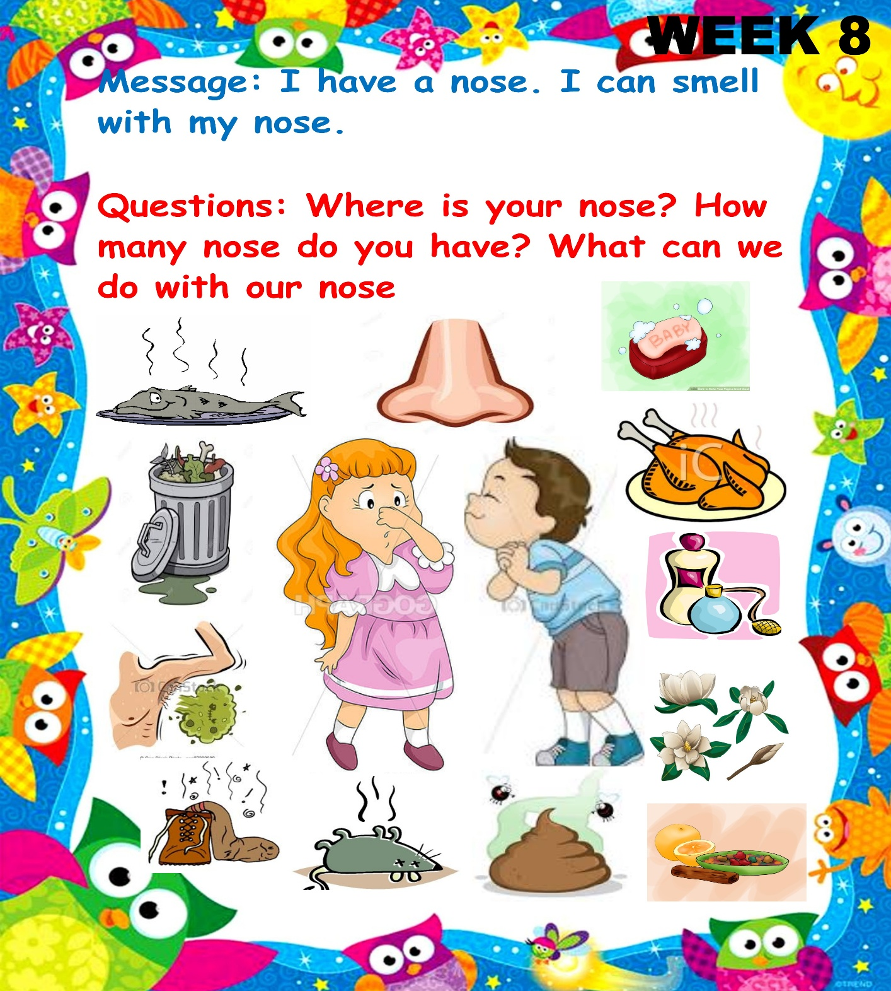
What can we do with our nose?

Slide 5
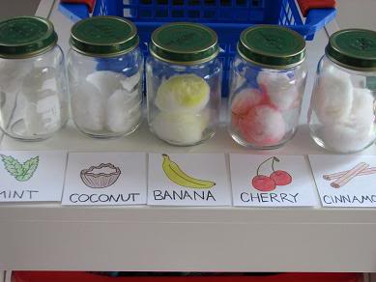
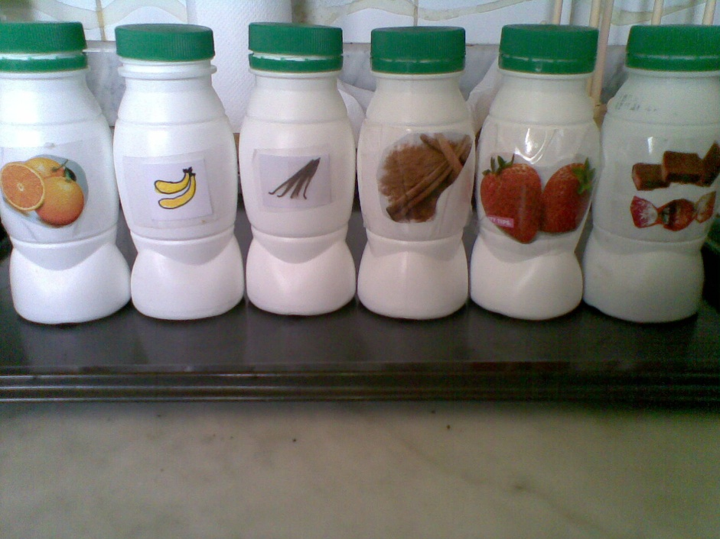
Smelling Jars

Slide 6
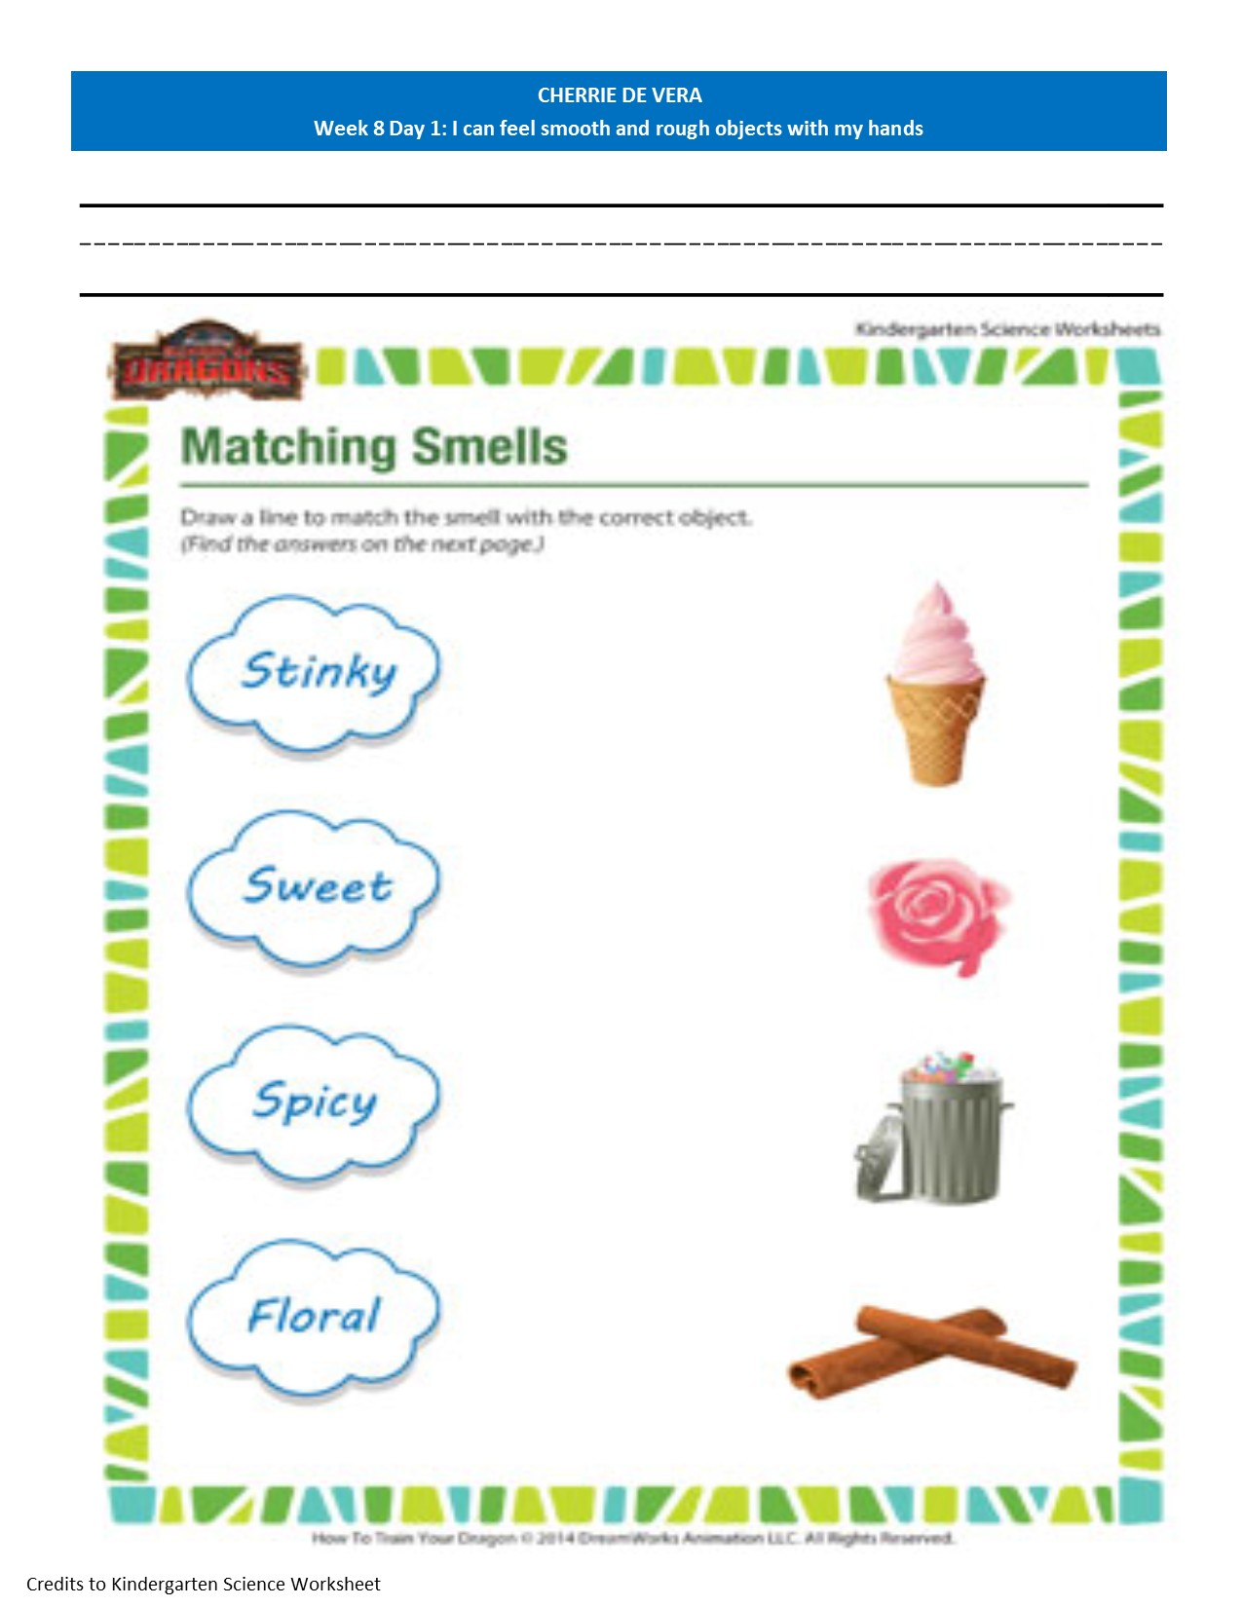
Match and Smell Worksheet

Slide 7
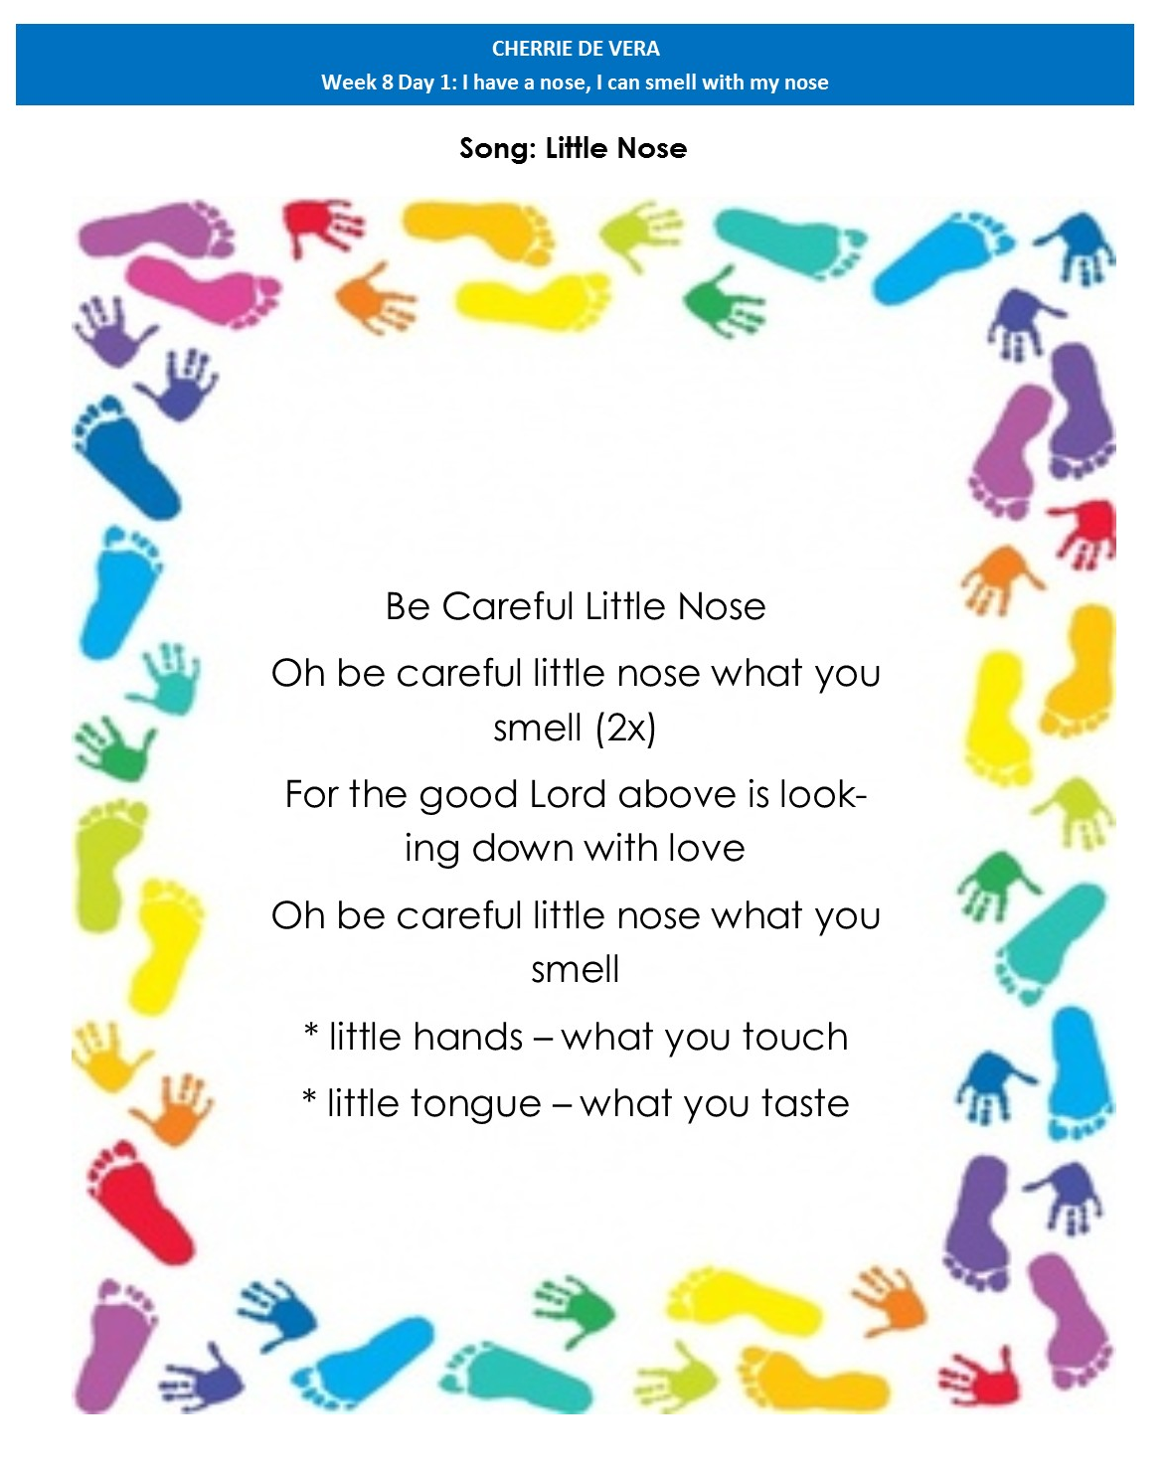
Song: Little Nose

Slide 8
Supervised Recess

Slide 9
Story Time:
Ang Prinsipeng Ayaw Maligo
by: Rene O. Villanueva

Slide 10
Story Time: Ang Prinsipeng Ayaw Maligo

Slide 11
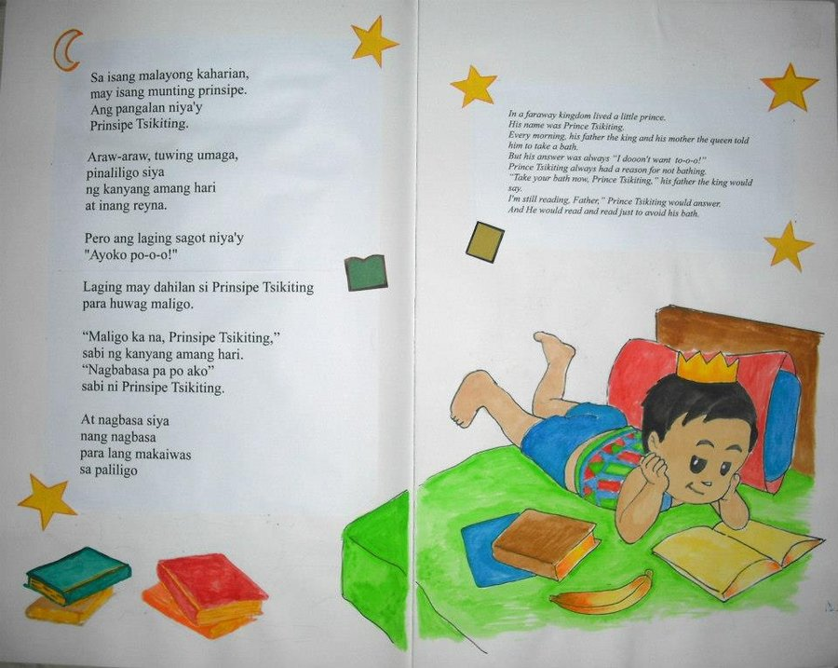
Story Time: Ang Prinsipeng Ayaw Maligo

Slide 12
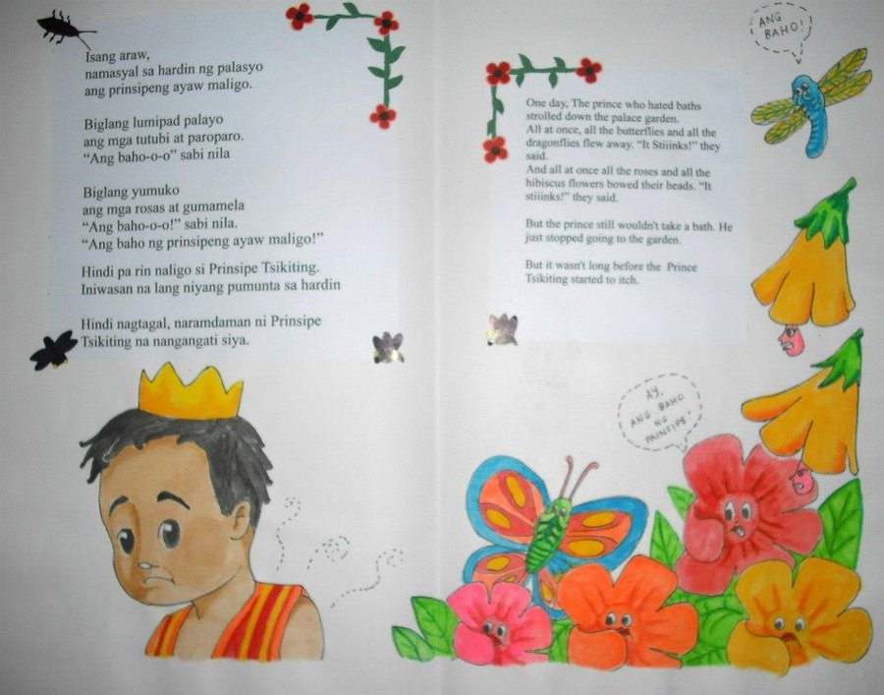
Story Time: Ang Prinsipeng Ayaw Maligo

Slide 13
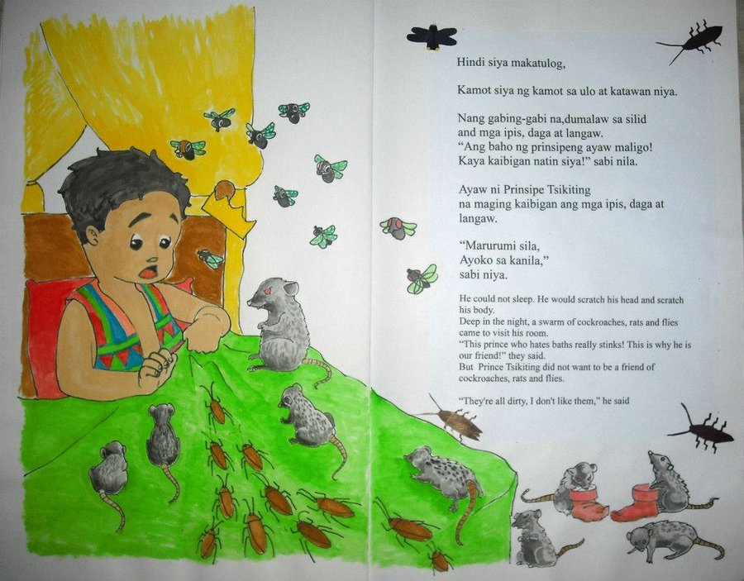
Story Time: Ang Prinsipeng Ayaw Maligo

Slide 14
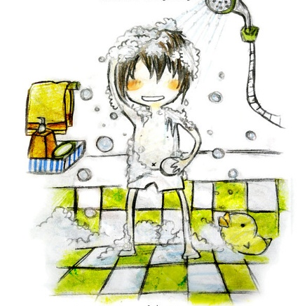
Story Time: Ang Prinsipeng Ayaw Maligo
Pagkagising, agad nagpunta sa banyo si Prinsipe Tsikiting. Naligo siya. Sinabon niyang mabuti ang kanyang buhok at katawan. Nagbuhos siya ng nagbuhos ng tubig para luminis ang kanyang katawan.

Slide 15
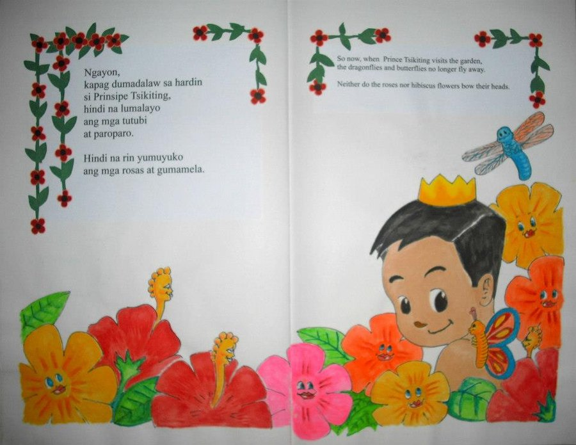
Story Time: Ang Prinsipeng Ayaw Maligo

Slide 16
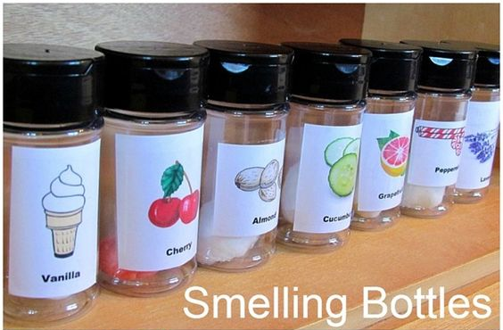
Same and Different Smell:
Materials: smelling jars used earlier (2 of each)
Procedure:
1.Blindfold each learner on his/her turn to smell.
2.Have the learner smell two canisters at a time and tell if they have the same scent or not.

Slide 17
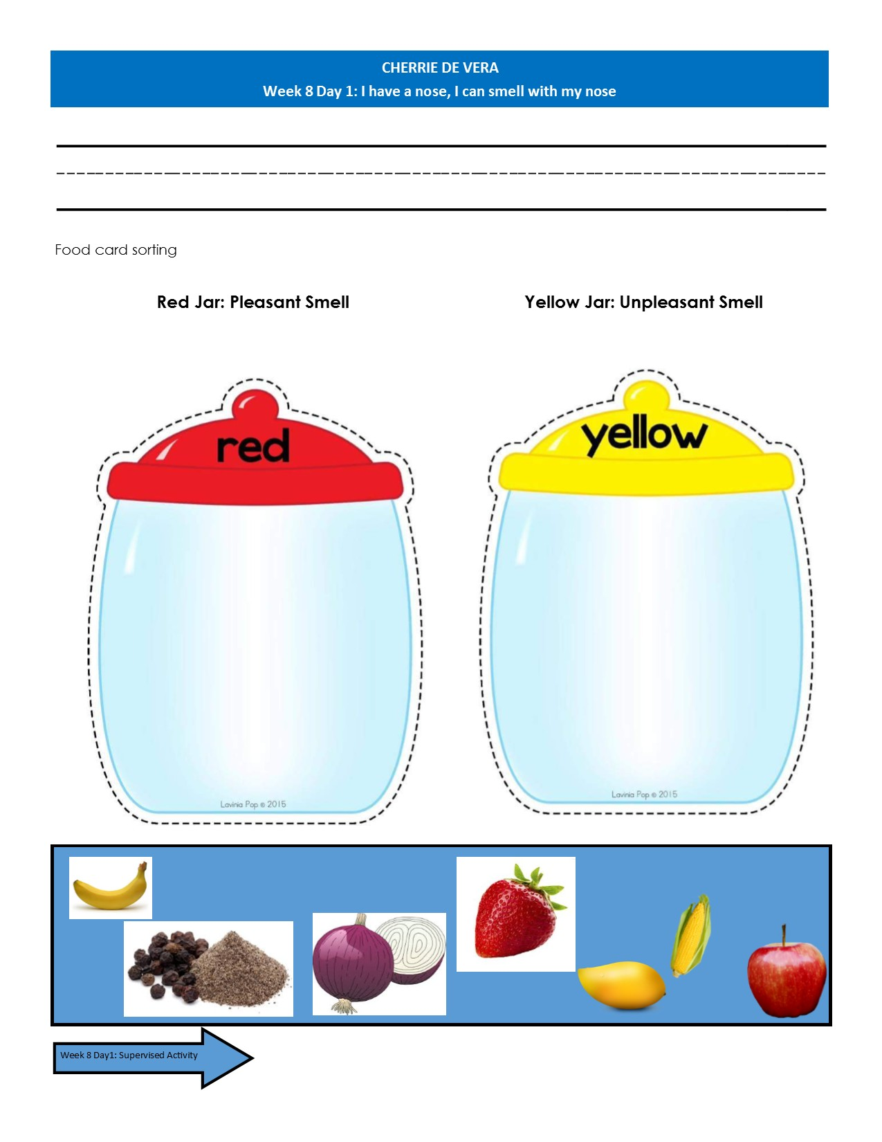
Food Card Sorting:
Sort the food cards according to smell: Pleasant and unpleasant

Slide 18
Pin the nose

Slide 19
Pin the nose

Slide 20
Dismissal Routine

