Slide 1
I Can Smell, Taste and Touch
Week 8
Power Point Presentation by
CHERRIE ANN A. DELA CRUZ

Slide 2
I can feel soft and hard objects with my hands.
DAY 2

Slide 3
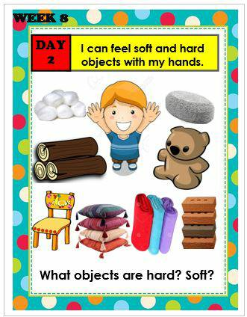
What objects are hard? Soft?

Slide 4
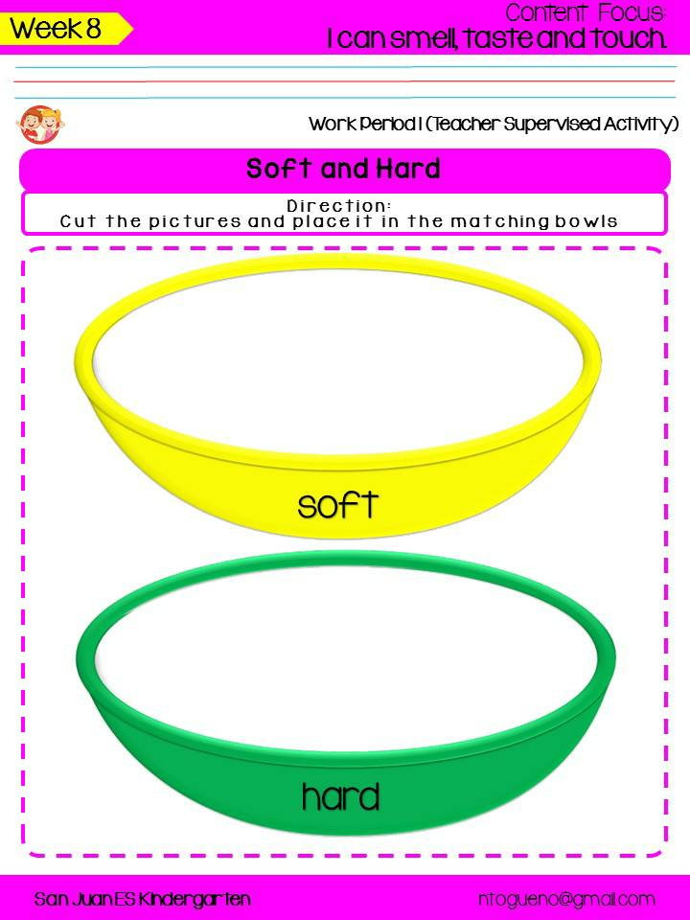
Touch and tell: soft and hard

Slide 5
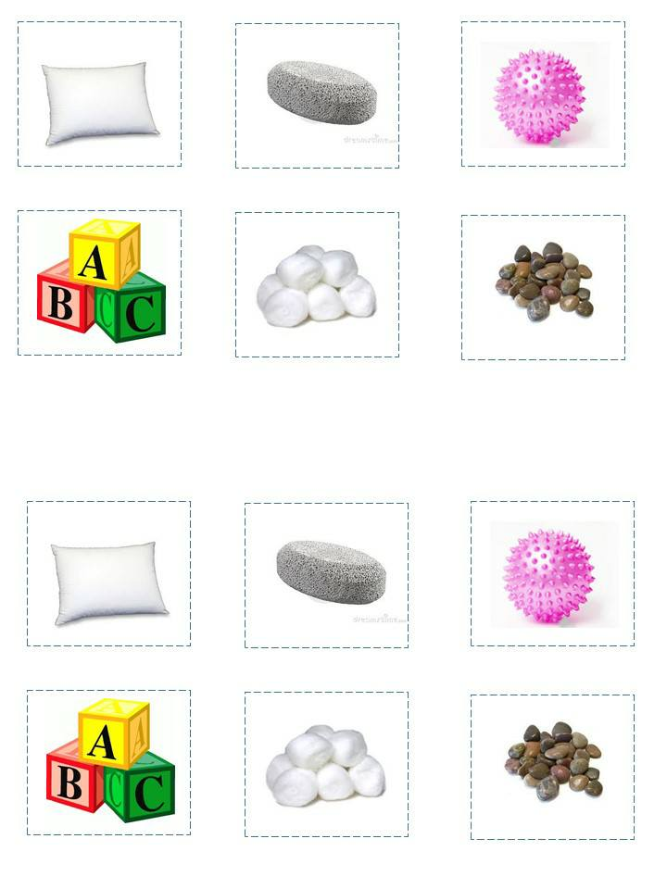
Touch and tell: soft and hard

Slide 6
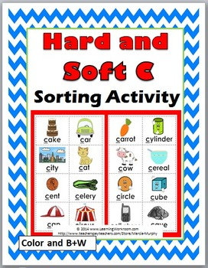
Texture Sorting

Slide 7
Song: Malambot at Matigas
Malambot at Matigas
Tune of “May Tatlong Bibe”
May dalawang bagay akong nakita
Upuan at bulak na nasa mesa
Ang isang bagay ay napakalambot
Ang isa naman at nakapatigas.
Ano? Ano ? Ano?
Alin? Alin? Alin?
Ano ang matigas at malambot?
Alin sa dalawa ang malambot?
Tayo ng suriin ang dalawa
Alin ang malambot?
Alin ang matigas?
Kung ang sagot mo ay tama at akma
Maupo ka na at ikaw ay magsaya.
Alin ang malambot? Bulak po ang sagot.
Alin ang matigas? Upuan po ang sagot
Tama ang sagot, tayo’ y pumalakpak.
Clap clap Clap ,clap clap clap
Tama ang sagot, tayo’ y pumalakpak.

Slide 8
Supervised Recess

Slide 9
Story Time:
Rumpelstiltskin
Play the Video

Slide 10
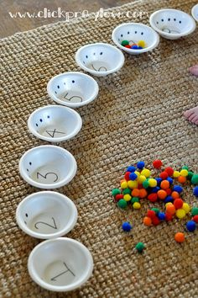
Lift the bowl (concrete up to quantities of 3)

Slide 11
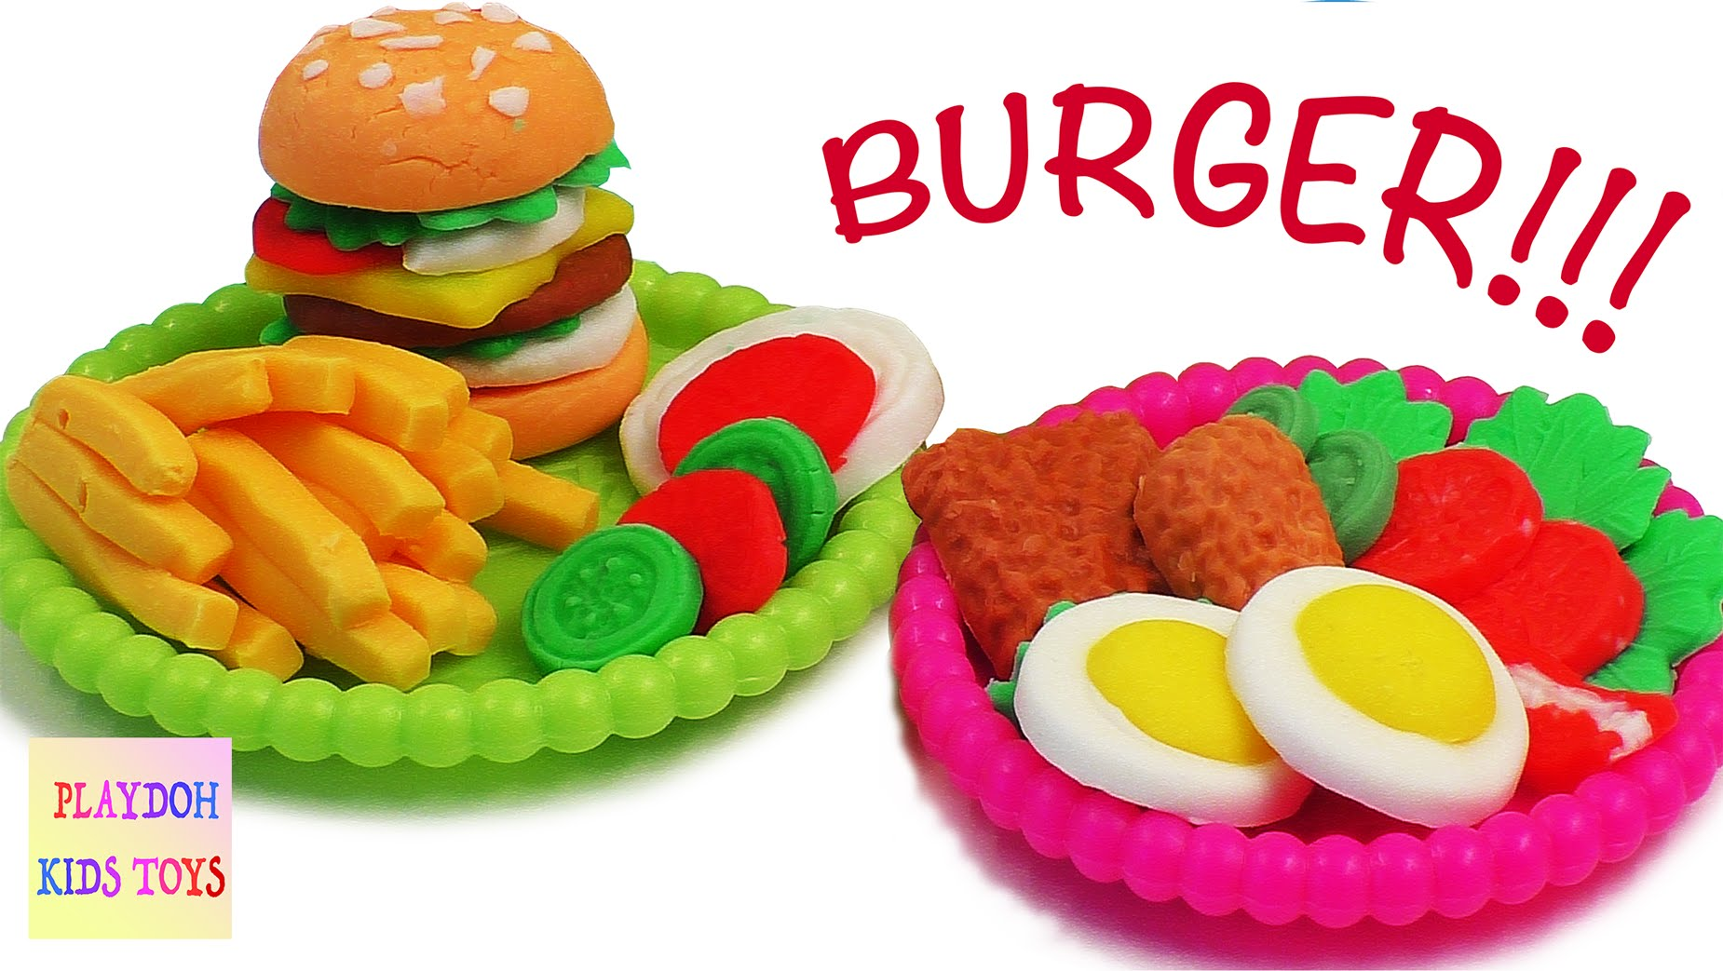
Play Dough Food
Materials: playdough
Procedure:
1. Allow the learners to make playdough food creations (cookies, spaghetti, bread, hotdog, etc.)

Slide 12
Ilong, Ilong, Ilong, Mata
Procedure:
1.Leader will say, “Ilong, Ilong, Ilong...” then another body part.
2.Leader confuses the players by pointing to the wrong body part.
3.Players point to the correct body part.
4.Whoever points to the wrong body part is out of the game.

Slide 13
Dismissal Routine

