Slide 1
I Can Smell, Taste and Touch
Week 8
Power Point Presentation by
CHERRIE ANN A. DELA CRUZ

Slide 2
I can feel smooth and rough objects with my hands.
DAY 3

Slide 3
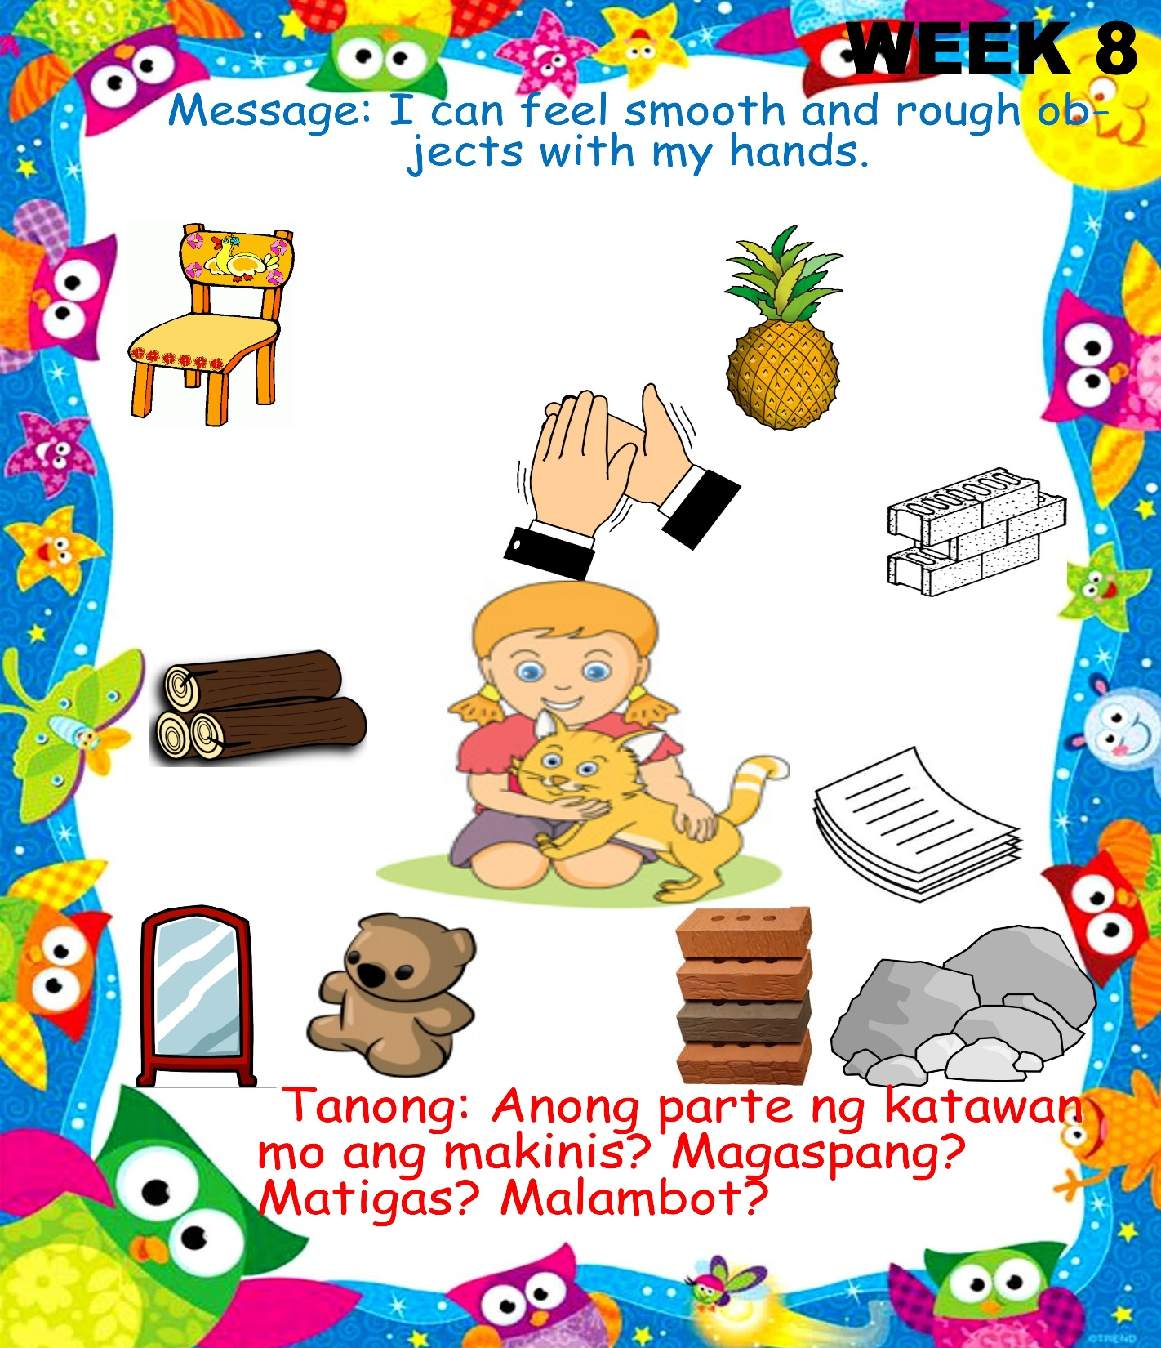
What objects are rough? Smooth?

Slide 4
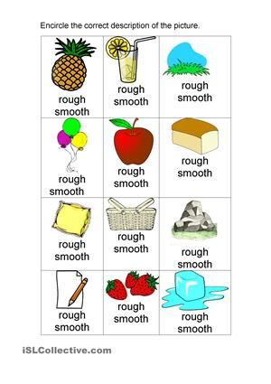
Touch and tell: smooth and rough

Slide 5
Texture Sorting

Slide 6
Song: Malambot at Matigas
Magaspang at Makinis
Tune of “May Tatlong Bibe”
May dalawang bagay akong nakita
Upuan at bulak na nasa mesa
Ang isang bagay ay napakagaspang
Ang isa naman at napakakinis.
Ano? Ano ? Ano?
Alin? Alin? Alin?
Ano ang matigas at napakagaspang?
Alin sa dalawa ang napakakinis?
Tayo ng suriin ang dalawa
Alin ang magaspang?
Alin ang makinis?
Kung ang sagot mo ay tama at akma
Maupo ka na at ikaw ay magsaya.
Alin ang magaspang? Bulak po ang sagot.
Alin ang makinis? Upuan po ang sagot
Tama ang sagot, tayo’ y pumalakpak.
Clap clap Clap ,clap clap clap
Tama ang sagot, tayo’ y pumalakpak.

Slide 7
Supervised Recess

Slide 8
Story Time:
Ang Prinsesang Ayaw Matulog
by:Feny delos Angeles-Bautista

Slide 9
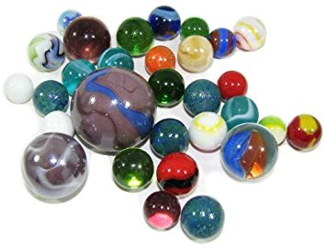
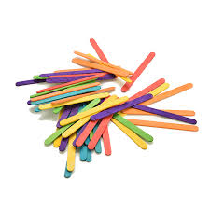
Hand Game: connecting level up to quantities of 3

Slide 10
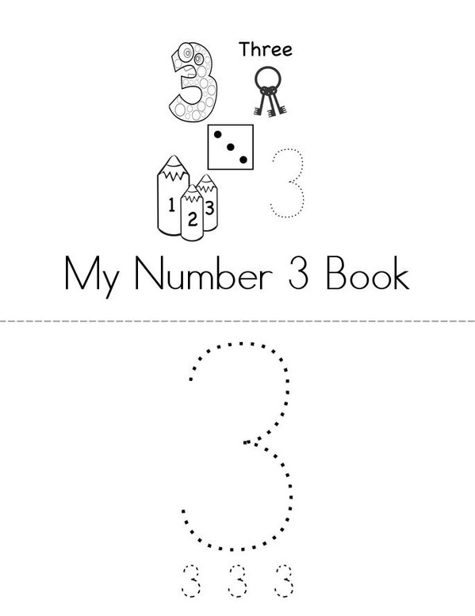
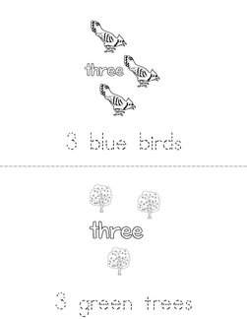
Number Book: Quantities of 3

Slide 11
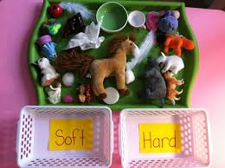
Indoor/Outdoor: Soft Hard Relay
Materials: soft and hard objects inside a bucket, two trays labeled soft and hard
Procedure:
1.Group the learners into 2.
2.They will form a line.
3.At the signal, the first player runs to the big bucket, gets an object, then shoot it in the correct tray.
4.Player 2 goes next and so on.
5.First group to finish and get all items correctly wins.

Slide 12
Dismissal Routine

