Slide 1
I Can Smell, Taste and Touch
Week 8
Power Point Presentation by
CHERRIE ANN A. DELA CRUZ

Slide 2
I have a mouth, teeth, lips and tongue. These help me speak and eat.
DAY 3

Slide 3
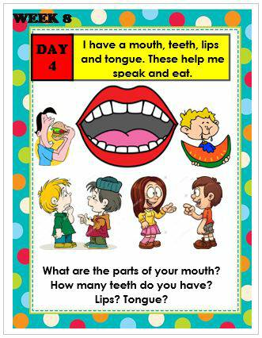

Slide 4
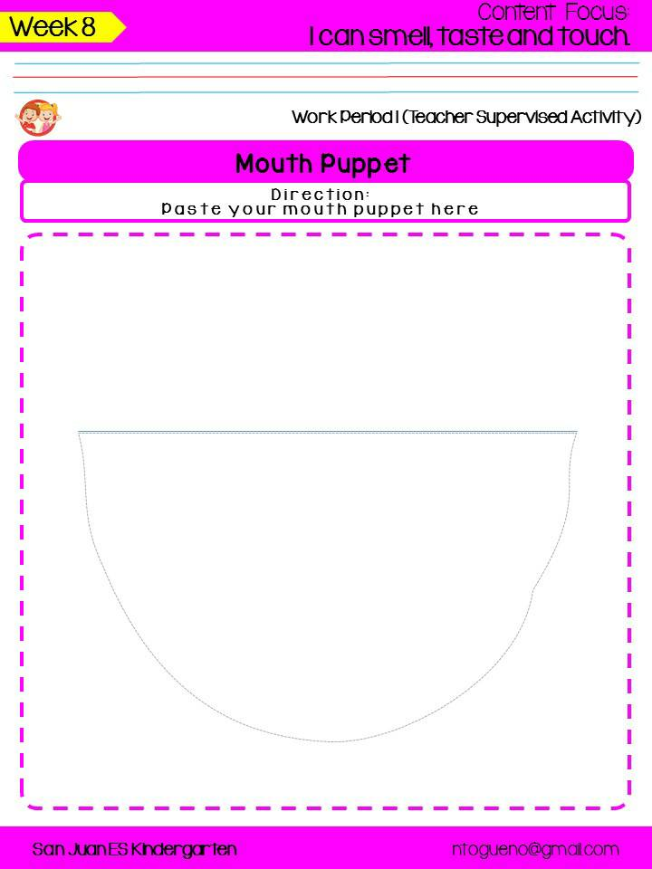
Mouth Puppet

Slide 5
Picture Puzzles

Slide 6
Tula: Ang Aking Bibig
Ang aking Bibig
(Likha ni Michille C. Castillon)
Dila kong maliit
Makikita sa aking bibig
Mga ngiping dikit dikit
Sa gilagid nakakabit.
Subuan mo ng pagkain
Ang bibig kong palakain
Malalaman nitong dila
Ang masarap nitong lasa.

Slide 7
Supervised Recess

Slide 8
Story Time:
Ha-Ha-Hatsinggg!
by: Luis P. Gatmaitan, MD

Slide 9
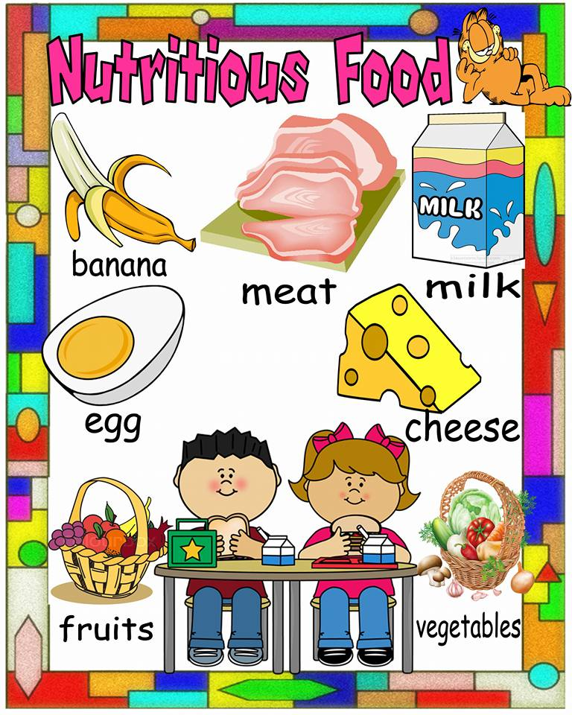
Favorite Food Survey

Slide 10
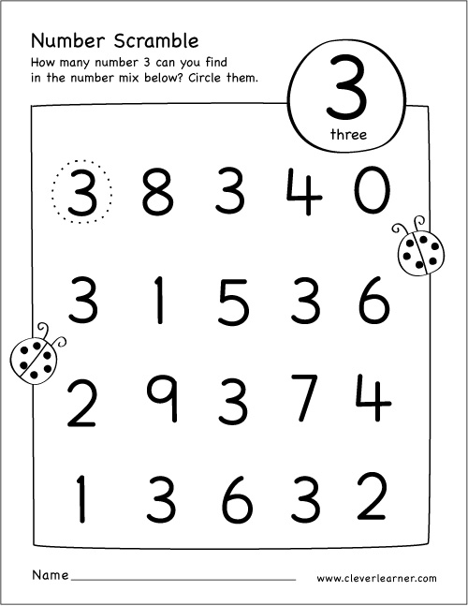
Find 3

Slide 11
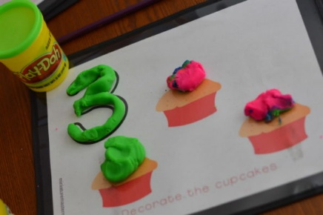
Indoor/Outdoor: Unstructured Free Play

Slide 12
Dismissal Routine

