Slide 1
I Can Smell, Taste and Touch
Week 8
Power Point Presentation by
CHERRIE ANN A. DELA CRUZ

Slide 2
I can taste with my tongue. I can identify different tastes.
DAY 3

Slide 3
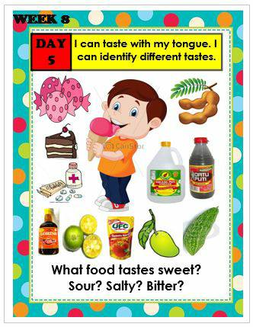

Slide 4
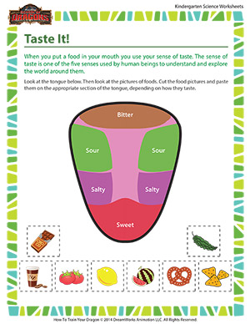
What food tastes sweet? What food tastes sour? What food tastes salty? What food tastes bitter?

Slide 5
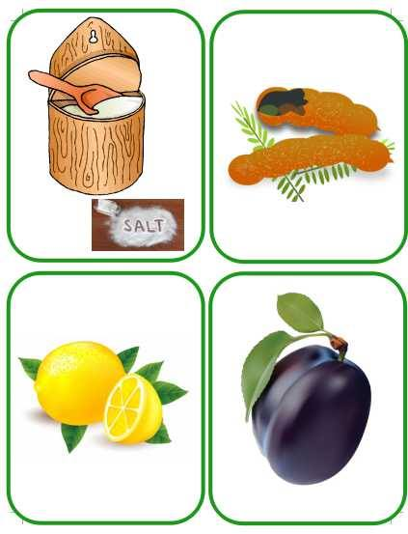
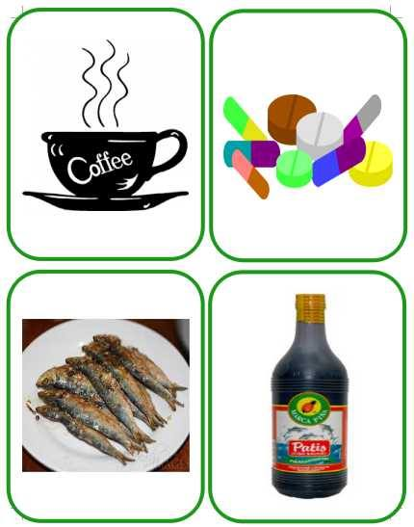
Name the taste

Slide 6
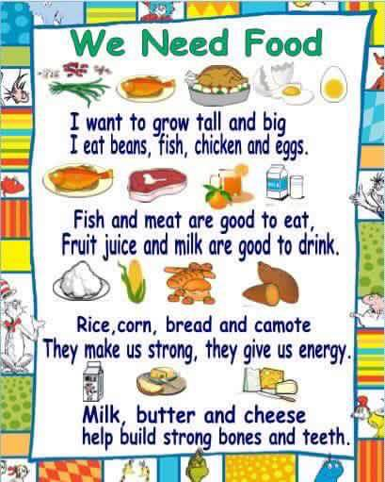
Food Chart

Slide 7
Tula: Kung ang Ulan ay Puro Tsokolate
Kung Ang Ulan ay Puro Tsokolate
Kung ang ulan ay puro tsokolate
O kay tamis ng ulan
Ako’y labas at ako’y nganganga
A a a a a a a a a a …. o kay tamis ng ulan.
* katas ng calamansi – asim
* lasang kape - pait
Note: Words may be changed

Slide 8
Supervised Recess

Slide 9
Story Time:
AHA! May Allergy Ka Pala!
by: Luis P. Gatmaitan, M.D.

Slide 10
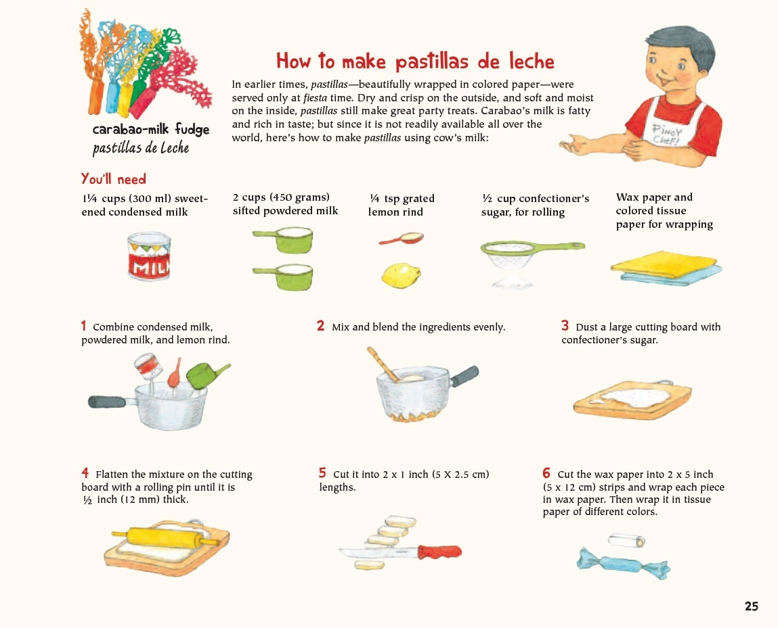
Make Pastillas

Slide 11
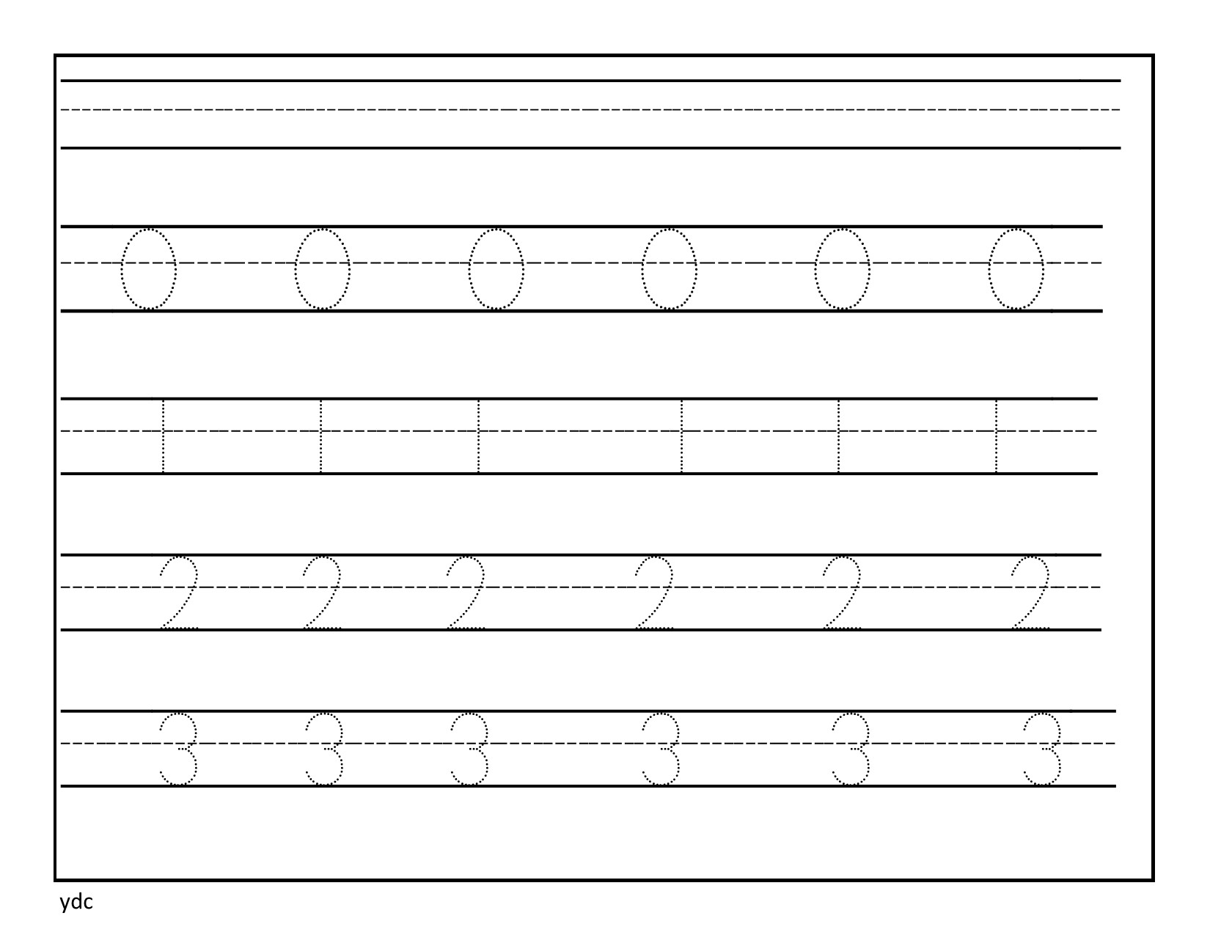
Write Numerals 0-3

Slide 12
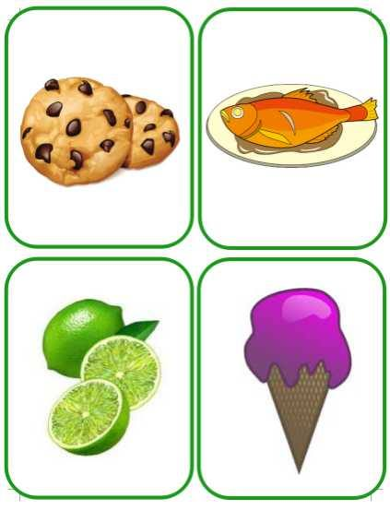
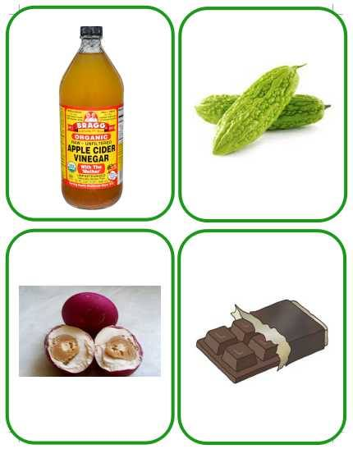
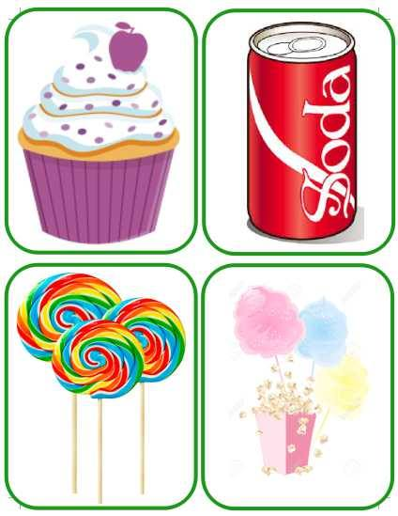
Indoor/Outdoor: Food Henyo
Procedure:
1.Choose a learner to be the guesser.
2.Set the timer to 2 minutes.
3.Pick a card. Do not show to the guesser but show to the other players.
4.The guesser will ask questions answerable only by yes, no, or may be.
5.She/He will try to guess the food item based on clues.

Slide 13
Dismissal Routine

