Slide 1
I can take care of my body
Week 9
Power Point Presentation by
Cherrie Ann A. Dela Cruz

Slide 2
I keep my body clean by taking a bath. I use soap for my body and shampoo for my hair.
Week 9 Day 1
Power Point Presentation by
Cherrie Ann A. Dela Cruz

Slide 3
Did you take a bath before going to school?

Slide 4
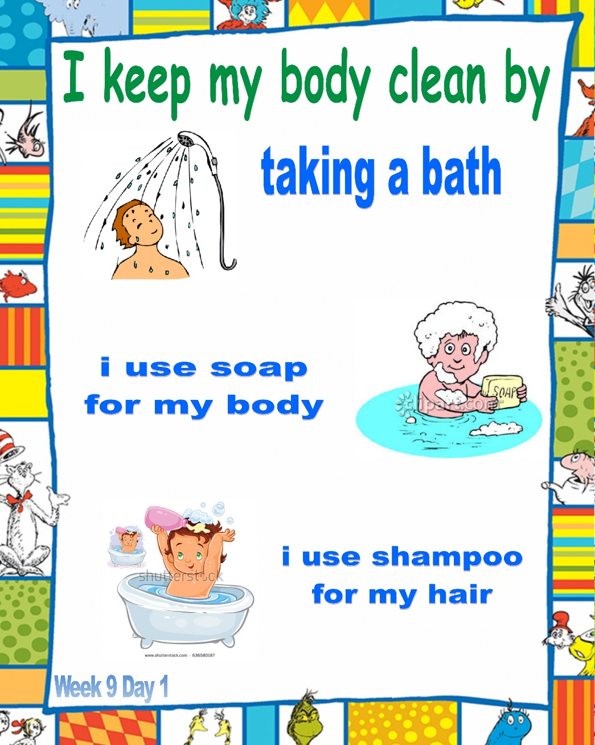
What did you use in taking a bath?

Slide 5
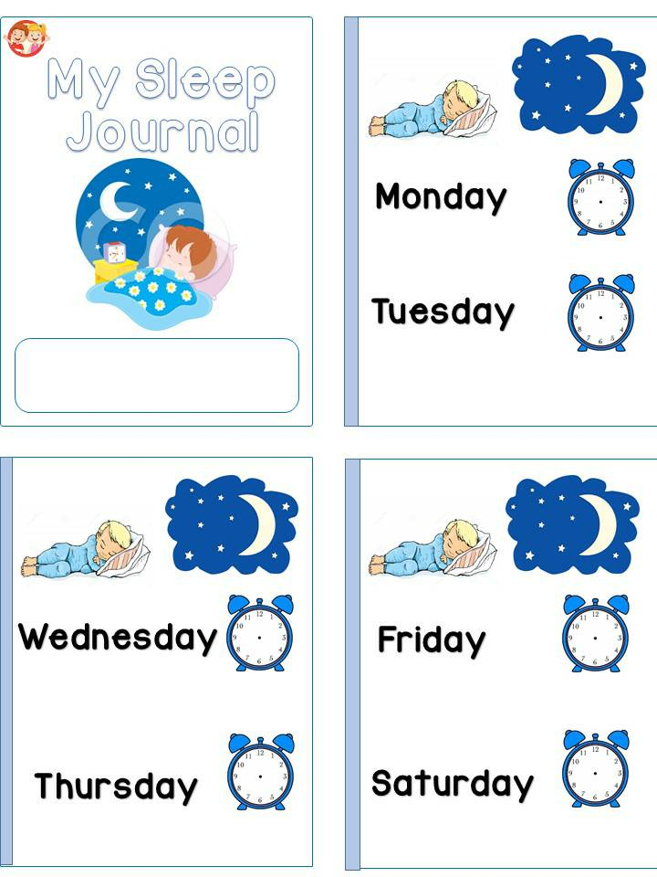
Sleep Journal

Slide 6
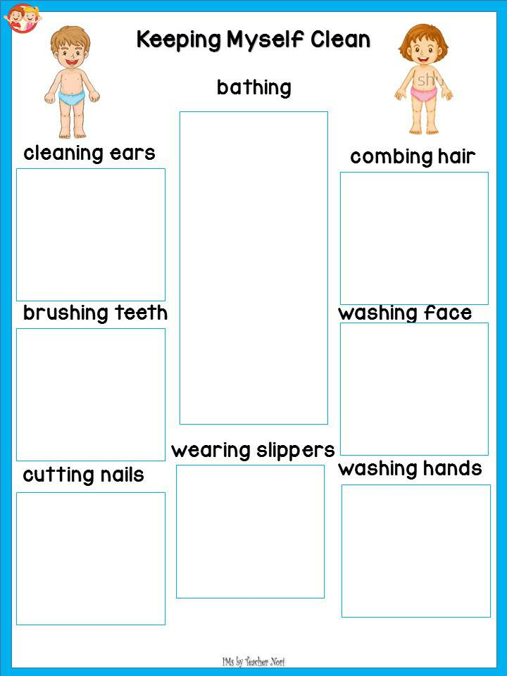
Cleaning the body

Slide 7
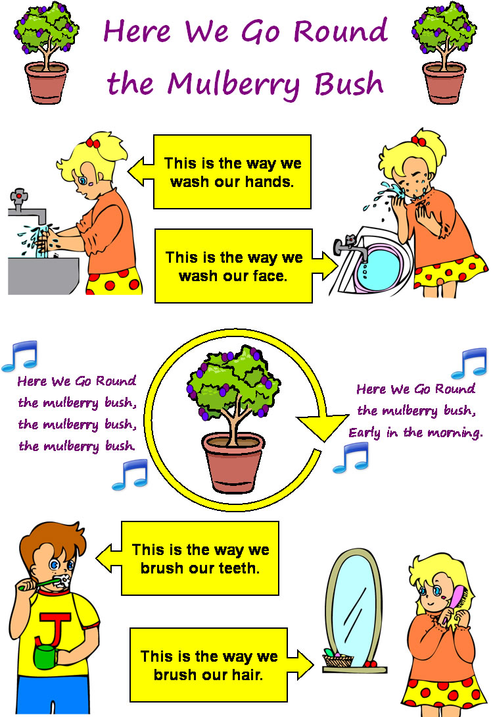
Song: This is the way

Slide 8
Supervised Recess

Slide 9
Story Time
May Lihim Kami ni Ingkong
By: Luis P. Gatmaitan MD

Slide 10
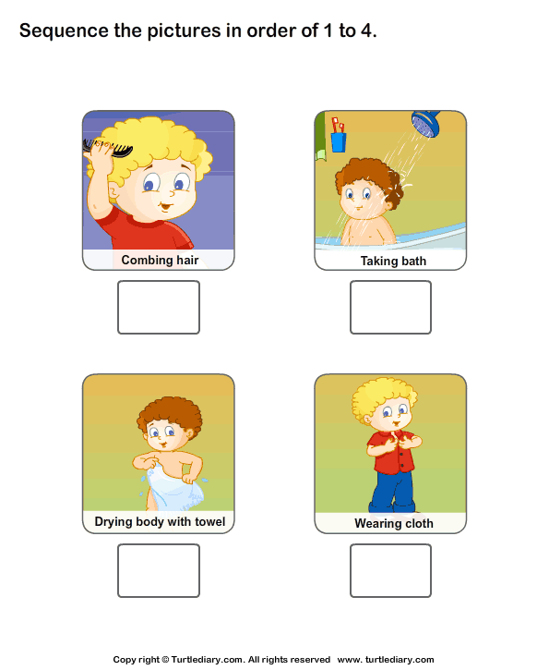
Bath Sequence

Slide 11
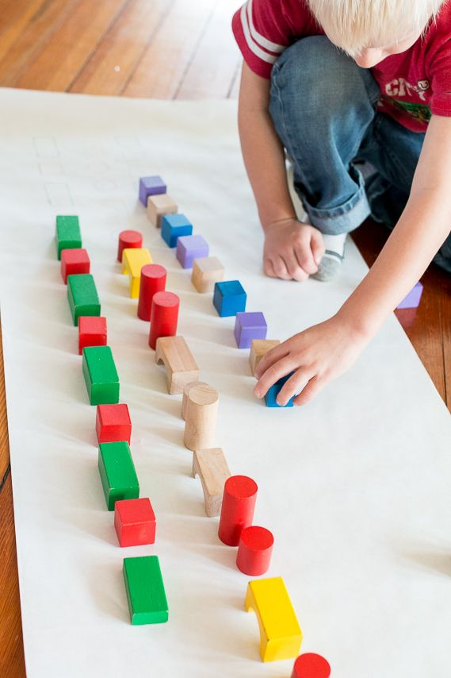
Block Conservation
Procedure:
Learners will play with similar pieces of blocks.
First, the blocks must be put one after the other.
Then, the blocks will have gaps in between.
Ask, “ Did the length when the blocks were moved?”
Arrange the blocks in other ways and explain that length of an object does not change even if it is moved.

Slide 12
Indoor/Outdoor Game: Larong Pinoy

Slide 13
Dismissal Routine

