Slide 1
I can take care of my body
Week 9
Power Point Presentation by
Cherrie Ann A. Dela Cruz

Slide 2
I wash my hands before and after eating. I brush my teeth after eating.
Week 9 Day 2
Power Point Presentation by
Cherrie Ann A. Dela Cruz

Slide 3
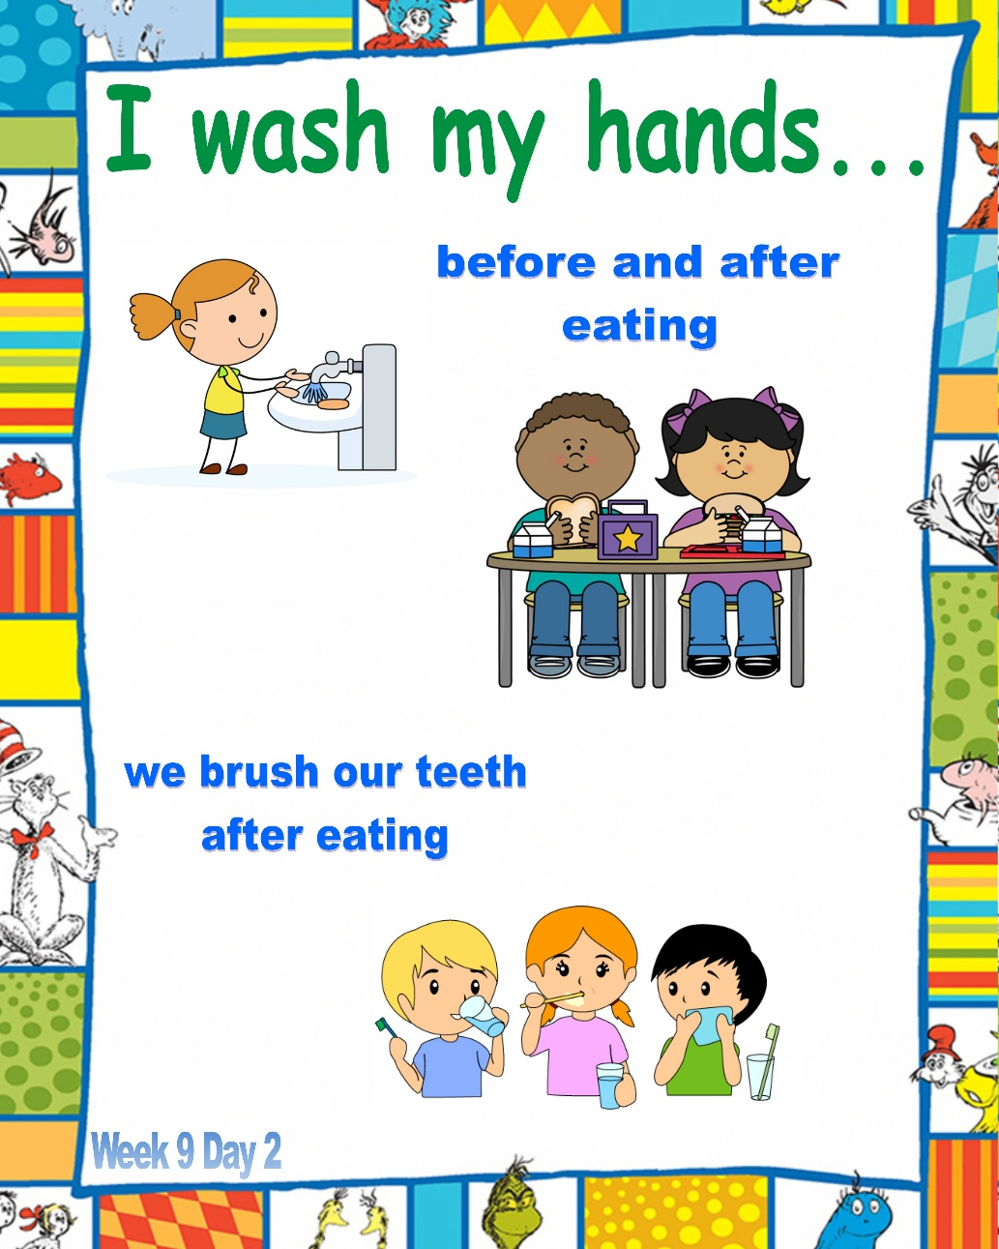
What do you do before and after eating?

Slide 4
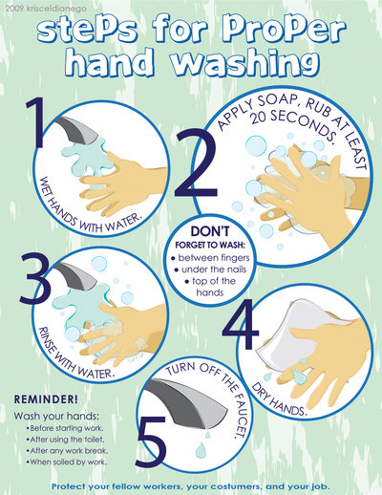
Steps in Proper Hand Washing

Slide 5
Steps in Proper Brushing of Teeth

Slide 6
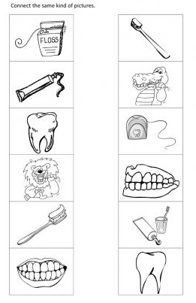
Picture Match

Slide 7
Song: Birthday Song

Slide 8
Supervised Recess

Slide 9
Story Time
Ang Inahing Manok

Slide 10
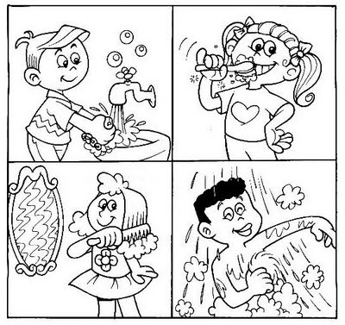
60 Seconds

Slide 11
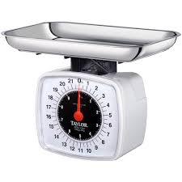
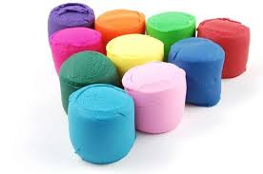
Playdough Conservation
Procedure:
1. Learners will play with an amount of playdough. Measure the mass of the playdough in the kitchen scale.
2. Next, pound the playdough flat. Measure its mass again.
3. Make the playdough into a ball. Measure again.
4. Ask, “Did the quantity change when the arrangement changed?”
5. Mold the playdough in other ways and measure after each arrangement.

Slide 12
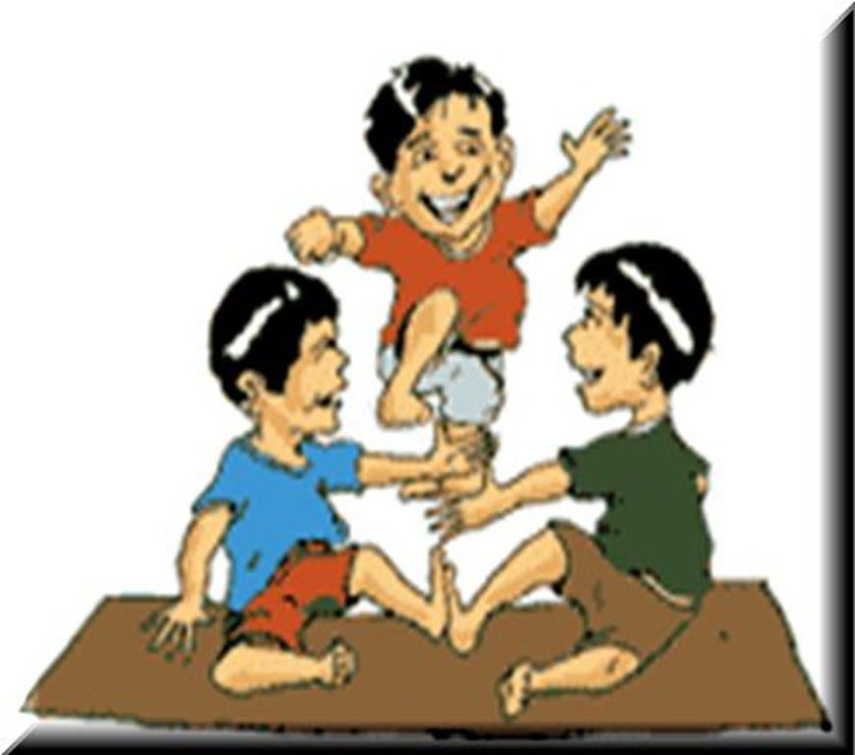
Indoor/Outdoor Game: Larong Pinoy

Slide 13
Dismissal Routine

