Slide 1
I can take care of my body
Week 9
Power Point Presentation by
Cherrie Ann A. Dela Cruz

Slide 2
I exercise every day to make my body strong. I play different sports to strengthen my muscles.
Week 9 Day 3
Power Point Presentation by
Cherrie Ann A. Dela Cruz

Slide 3
Why is exercise good for the body?

Slide 4
What sports do you like to play?

Slide 5
Mga Larong Pilipino

Slide 6
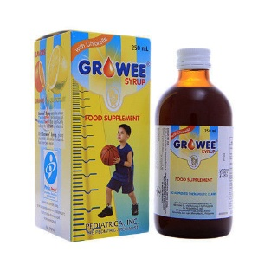
Vitamin Match

Slide 7
Supervised Recess

Slide 8
Story Time
Si Hugo
By: Charles Funk

Slide 9
Shooting Baskets
Materials: balls and baskets, scoreboard
Procedure:
1.Tell the learners that in professional basketball, a basket means two points.
2.Ask a pair of learners to work together – one will be the shooter, another will be the scorer.
3.Give the pair a minute. The shooter tries to shoot the balls in the basket and the

Slide 10
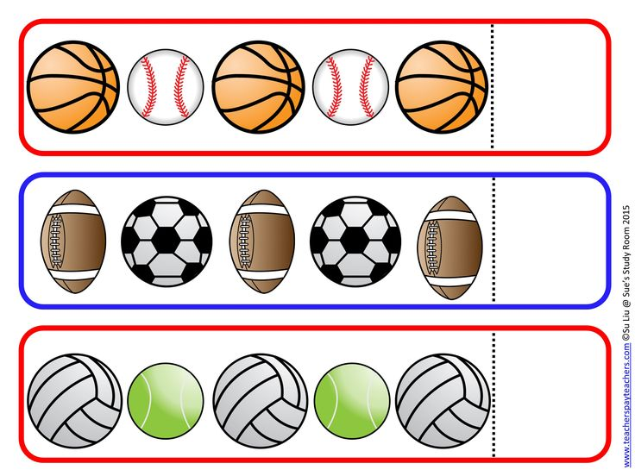
Sports Pattern

Slide 11
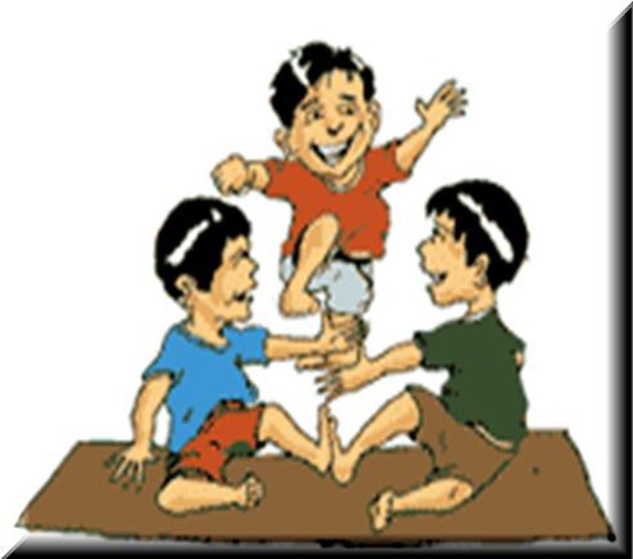
Indoor/Outdoor Game: Larong Pinoy

Slide 12
Dismissal Routine

