Slide 1
I can take care of my body
Week 9
Power Point Presentation by
Cherrie Ann A. Dela Cruz

Slide 2
I take vitamins for added nutrients.
Week 9 Day 4
Power Point Presentation by
Cherrie Ann A. Dela Cruz

Slide 4
ABC’s of essential vitamins

Slide 5
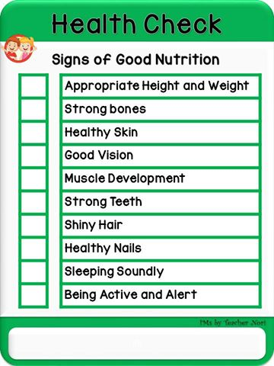
Health Check

Slide 6
Supervised Recess

Slide 7
Story Time
Ayan na si Bolet Bulate
By: Lius B. Gatmaitan, M.D.

Slide 8
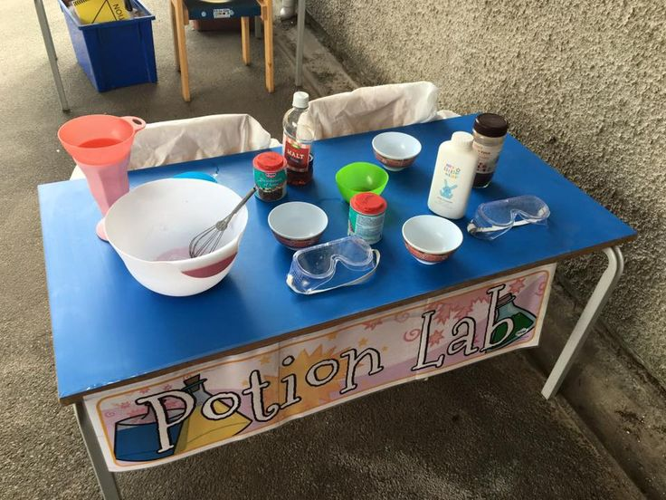
Pretend Pharmacist

Slide 9
Health Check

Slide 10
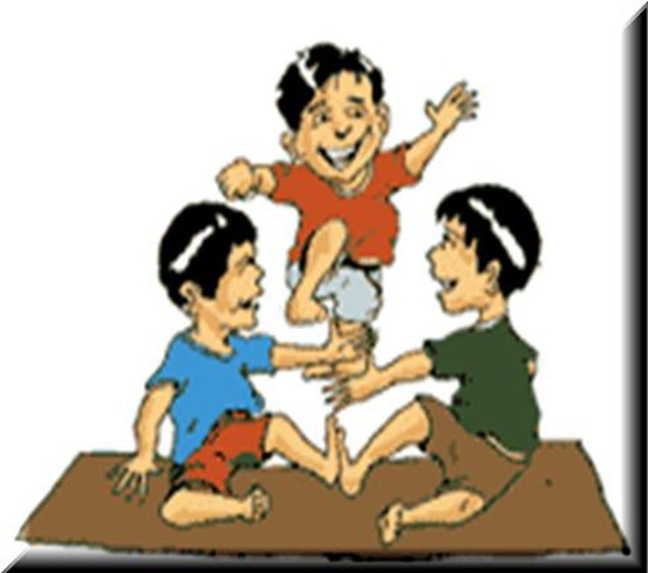
Indoor/Outdoor Game: Larong Pinoy

Slide 11
Dismissal Routine

